Slide 1
Darknet Markets in Principle
Tim K.

Slide 2
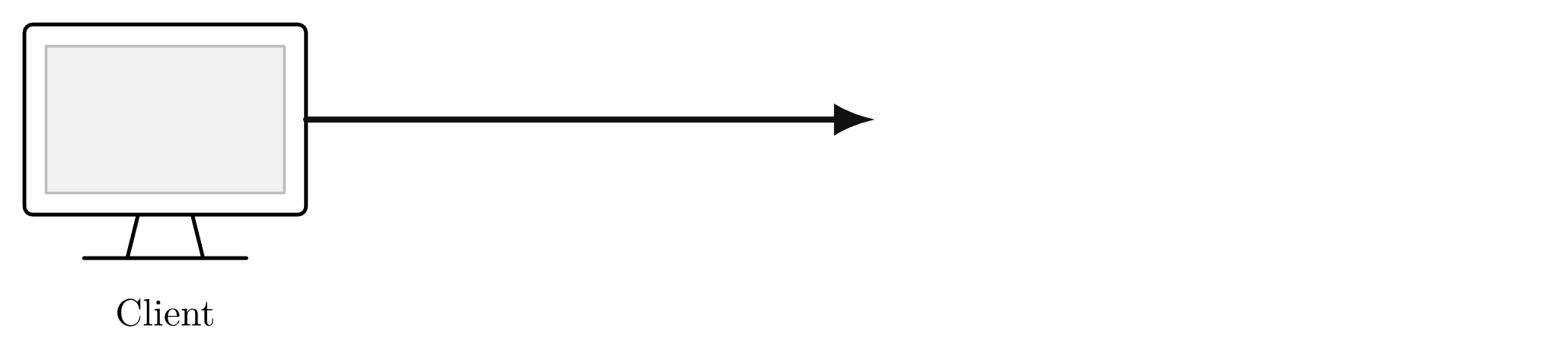

Buying on Amazon
2

Slide 3
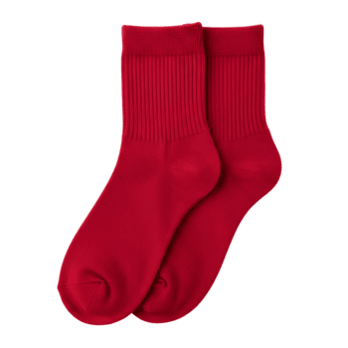
Buying on Amazon
3

Slide 4

Buying on Amazon
4

Slide 5
Buying on Amazon
Anonymity of the client
5

Slide 6
Buying on Amazon
Anonymity of the client
Anonymity of the server
6

Slide 7
Buying on Amazon
Anonymity of the client
Anonymity of the server
Anonymity of the payment
7

Slide 8
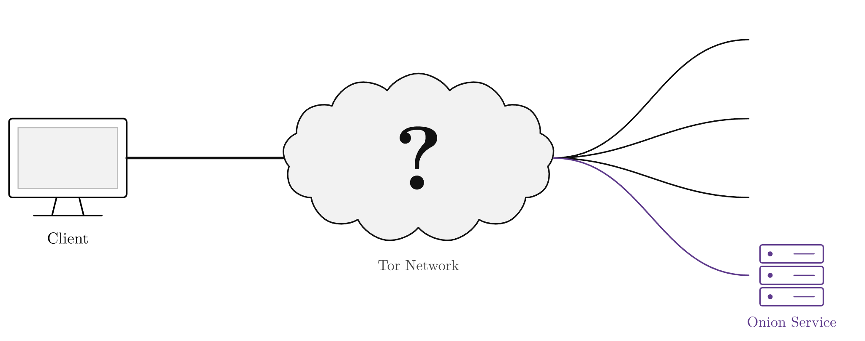



What is Tor?
8

Slide 9
How Tor Works
Part I

Slide 10
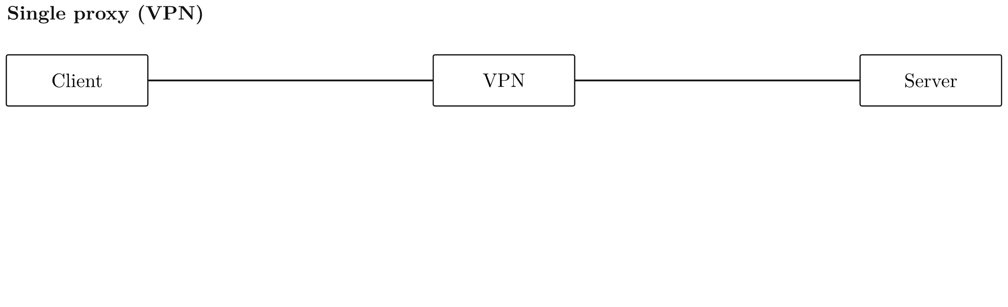
Single proxy vs. Tor circuit
10

Slide 11
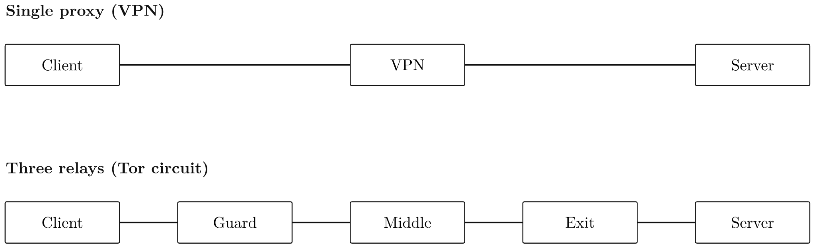
Single proxy vs. Tor circuit
11

Slide 12
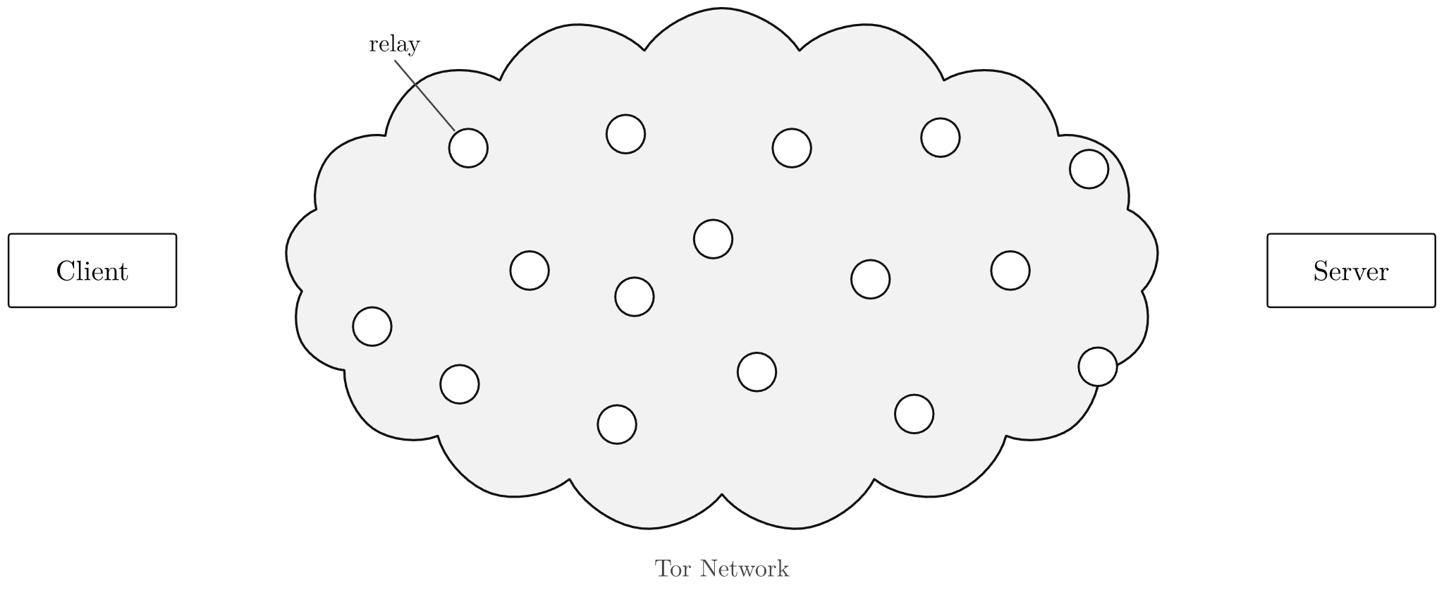
Tor relays
12

Slide 13
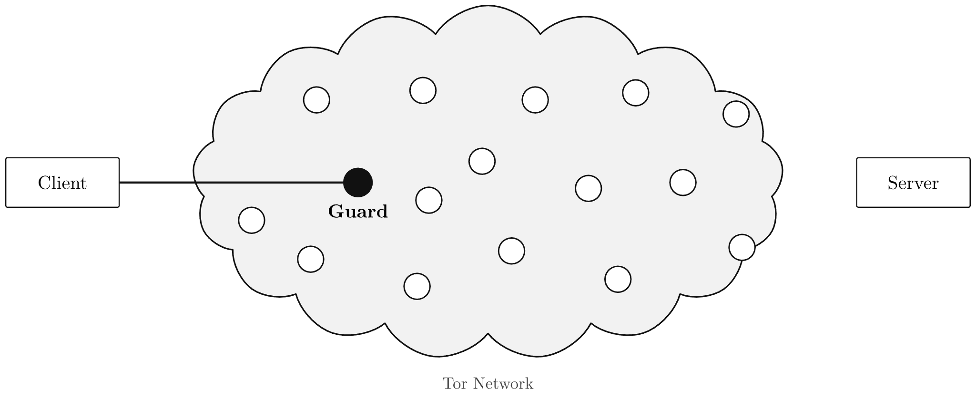
Tor relays
13

Slide 14
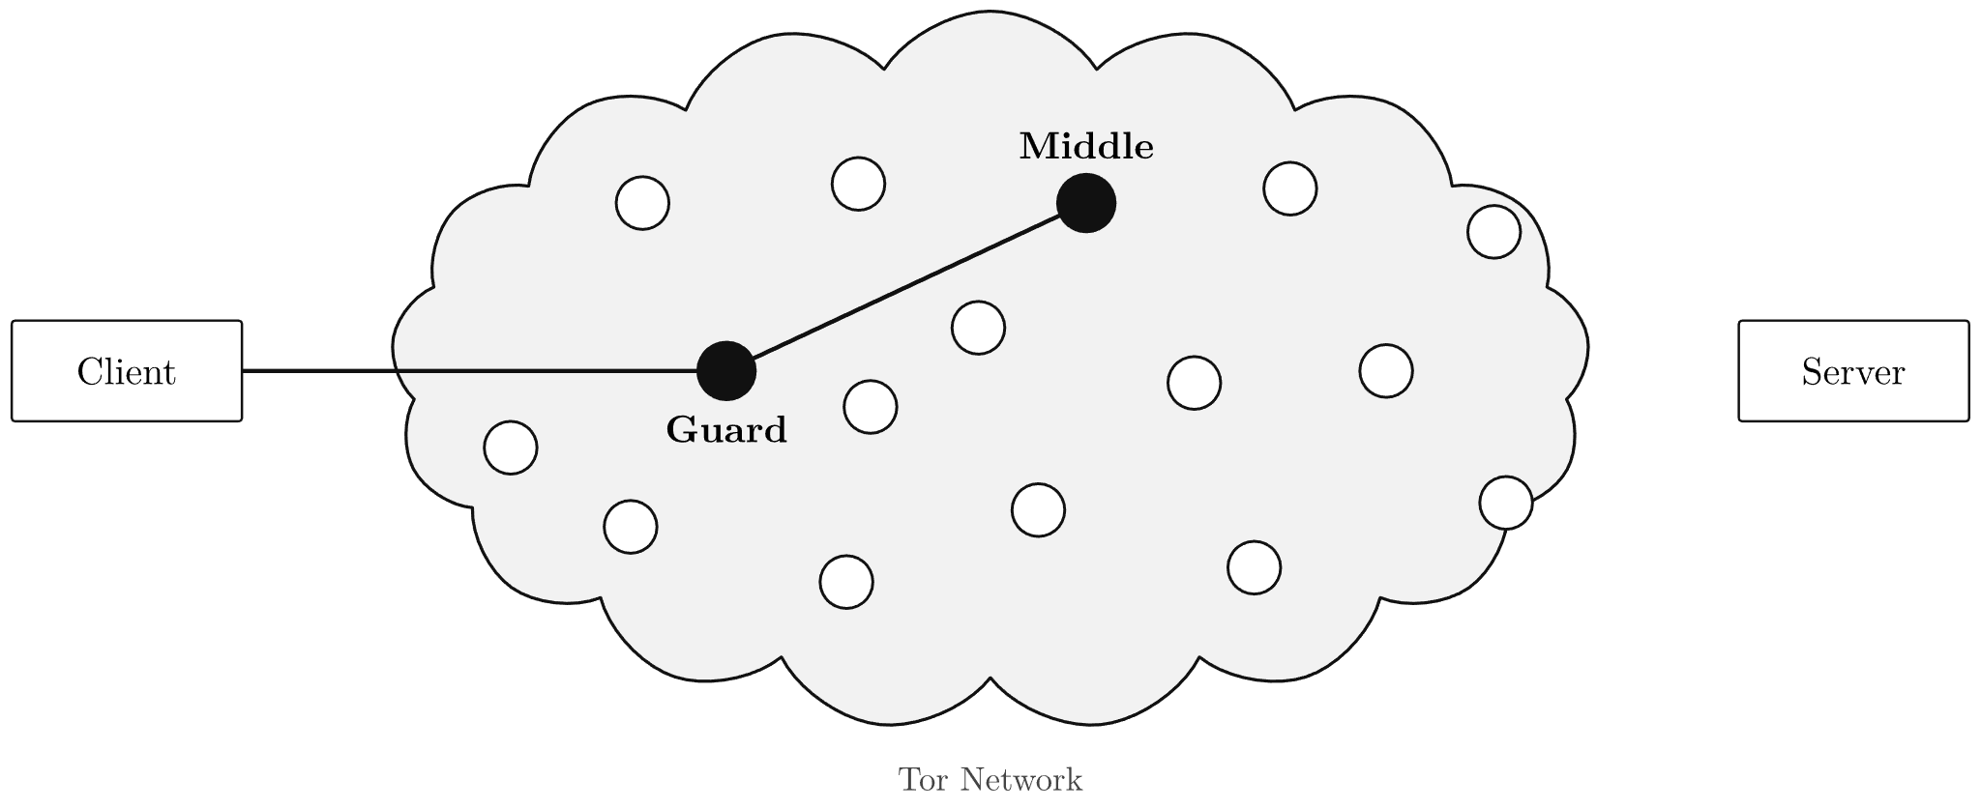
Tor relays
14

Slide 15
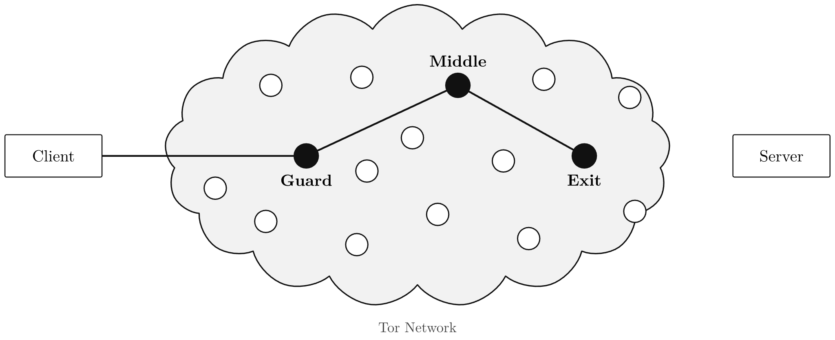
Tor relays
15

Slide 16
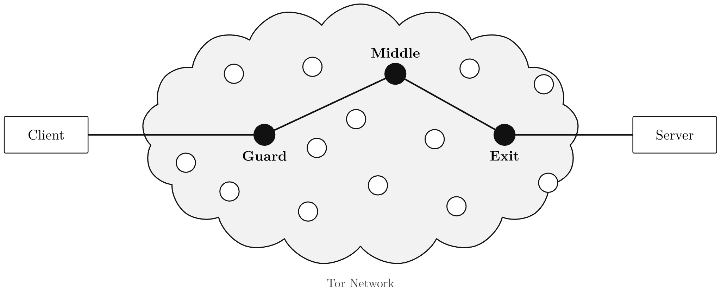
Tor relays
16

Slide 17
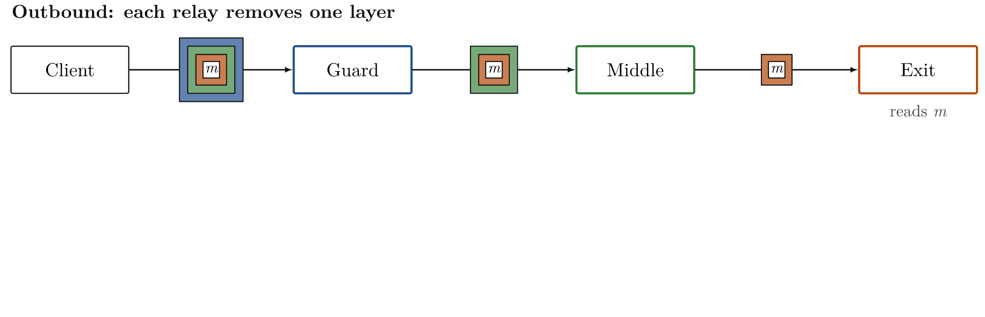
Layered encryption
17

Slide 18
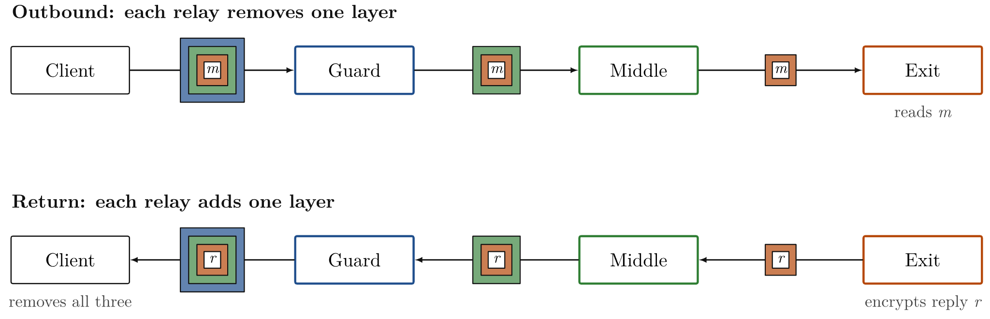
Layered encryption
18

Slide 19
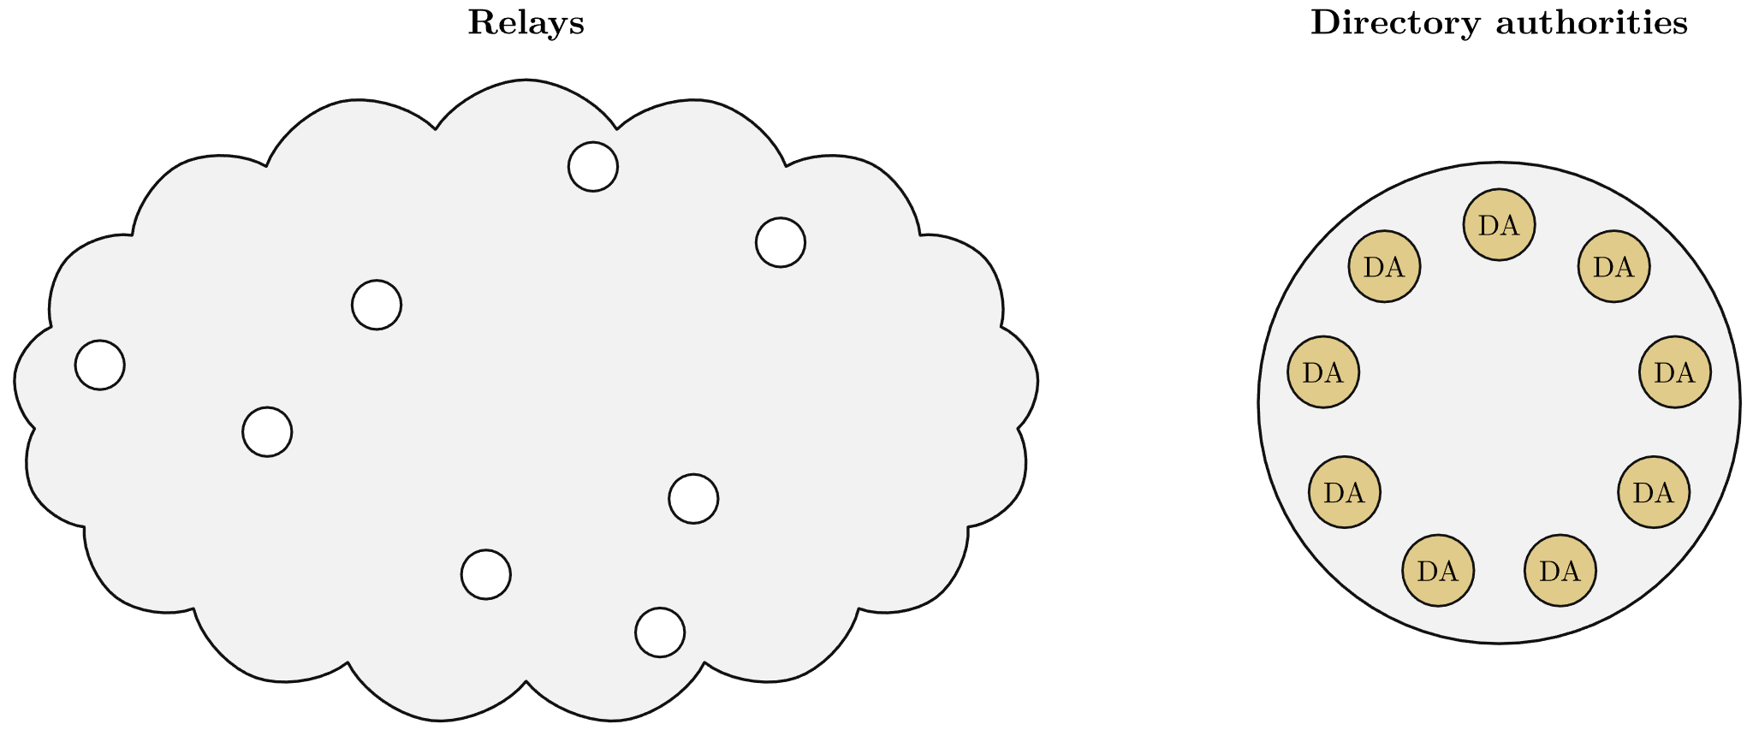
Directory consensus
19

Slide 20
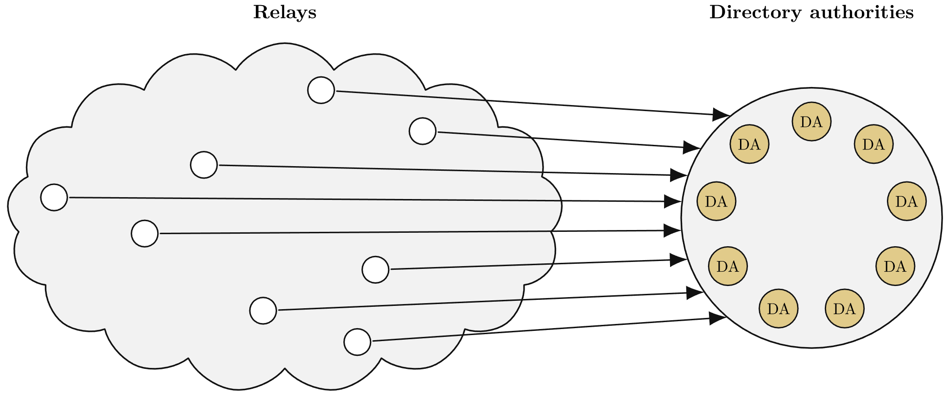
Directory consensus
20

Slide 21
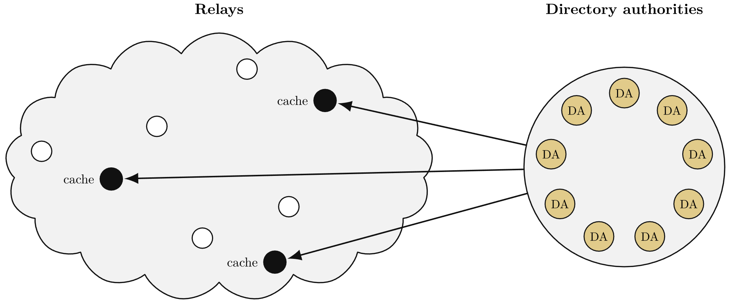
Directory consensus
21

Slide 22
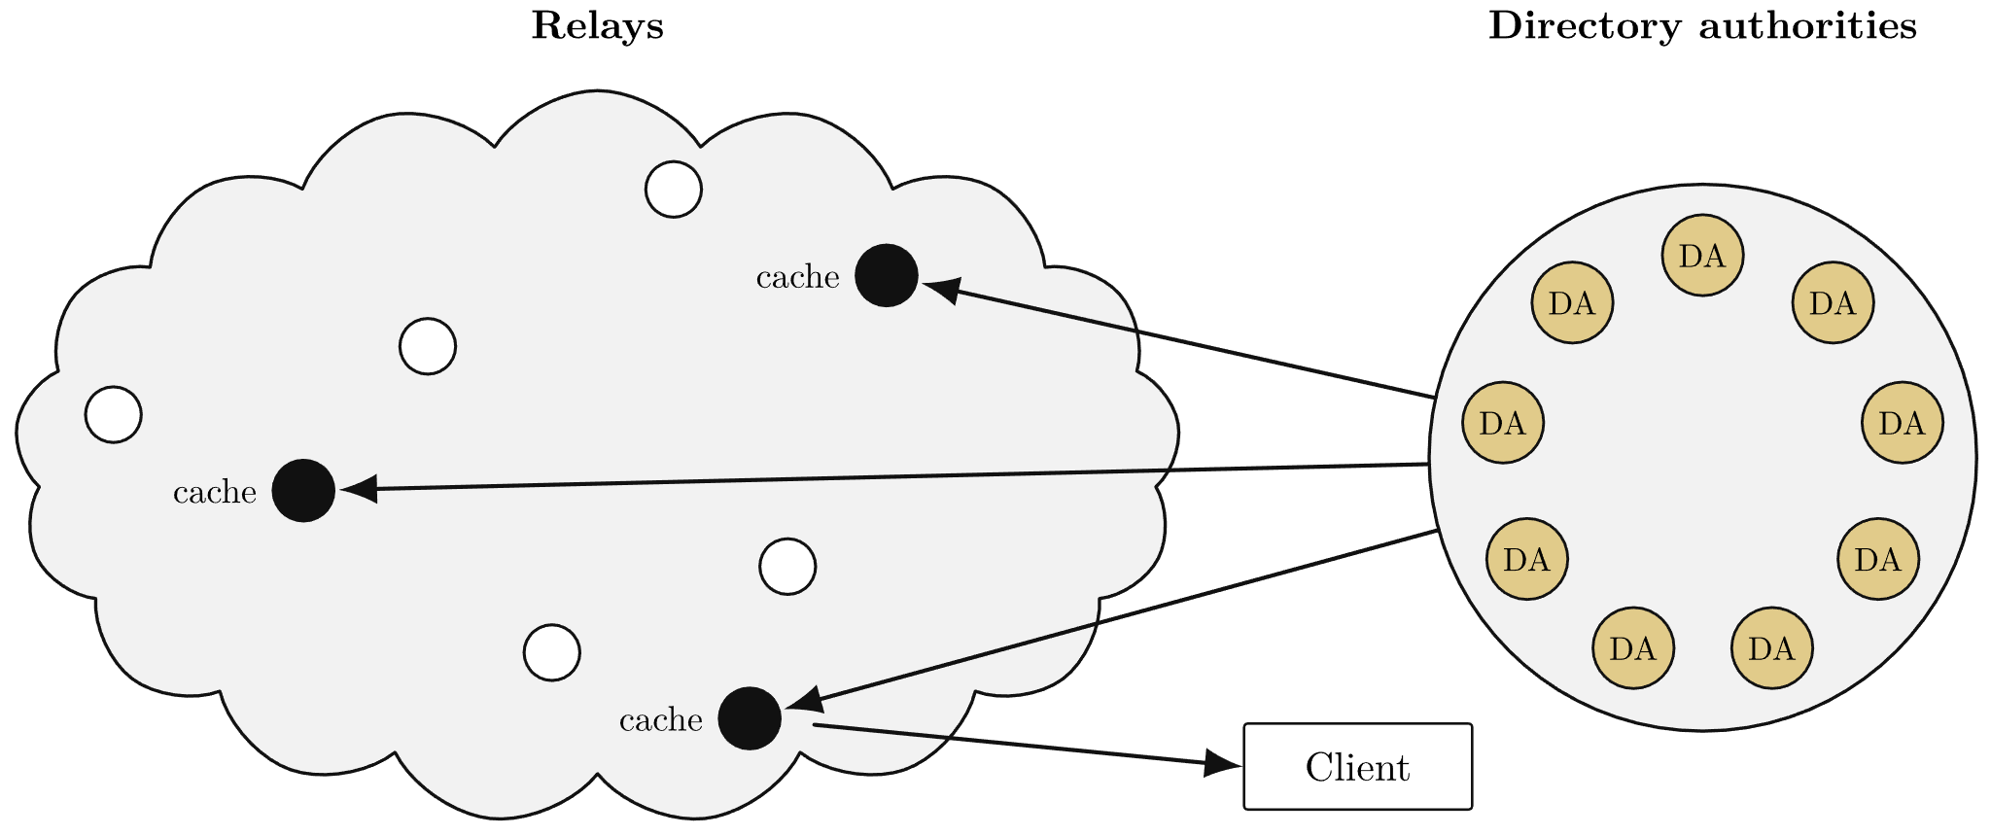
Directory consensus
22

Slide 23
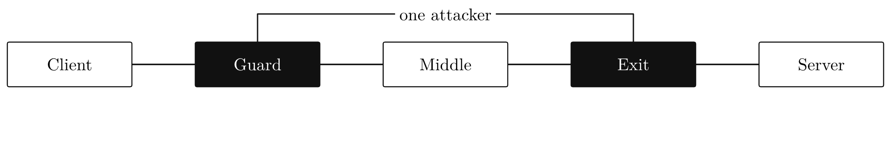
Controlling guard and exit
23

Slide 24
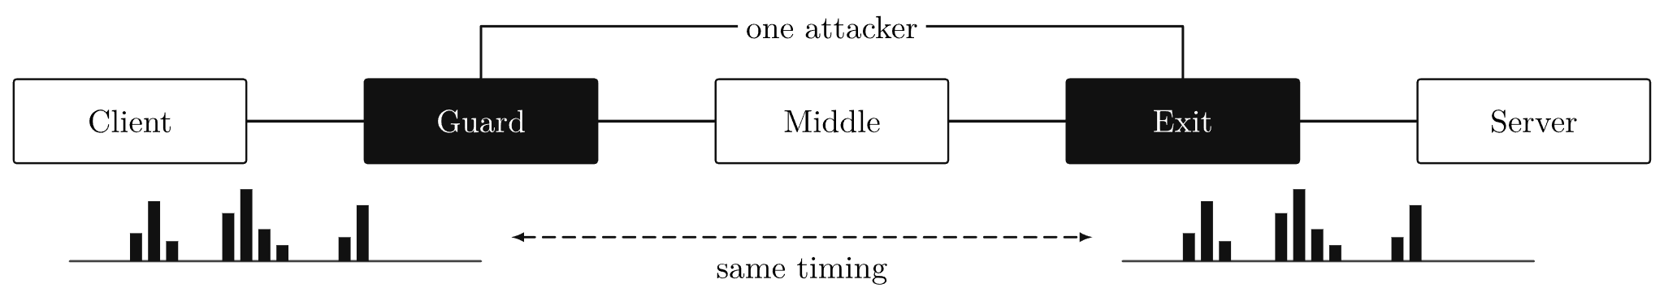
Controlling guard and exit
24

Slide 25
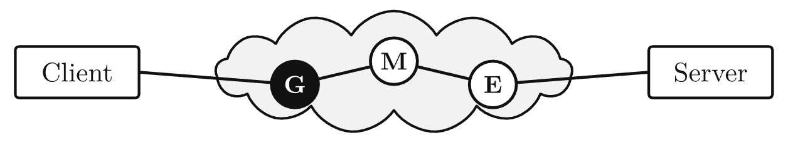
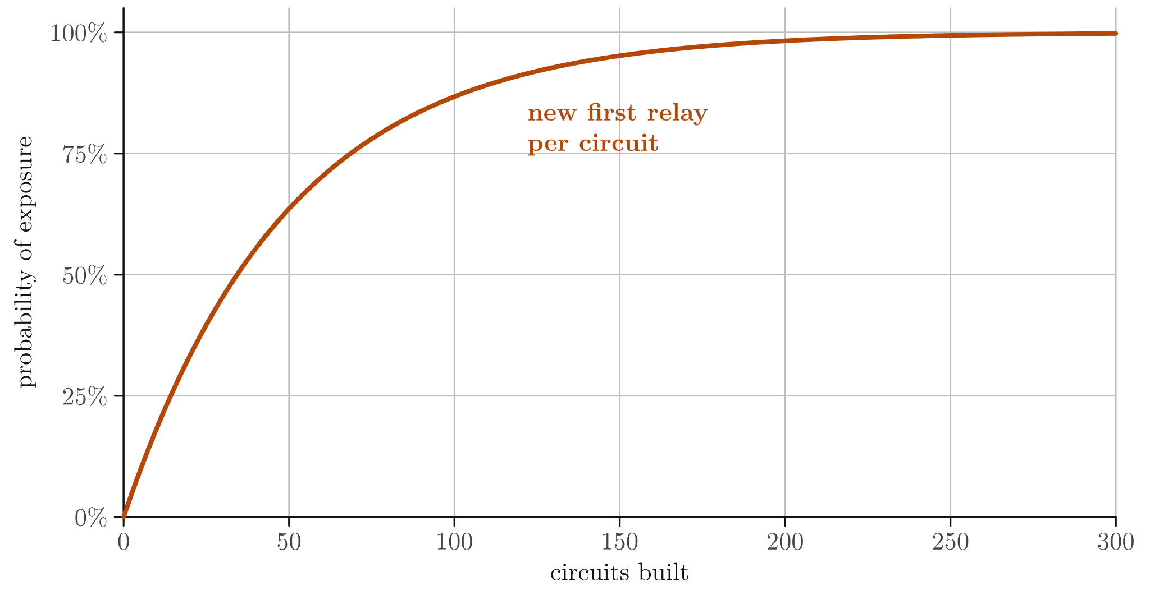
Guard selection
Model: attacker runs 2% of guard bandwidth
25

Slide 26
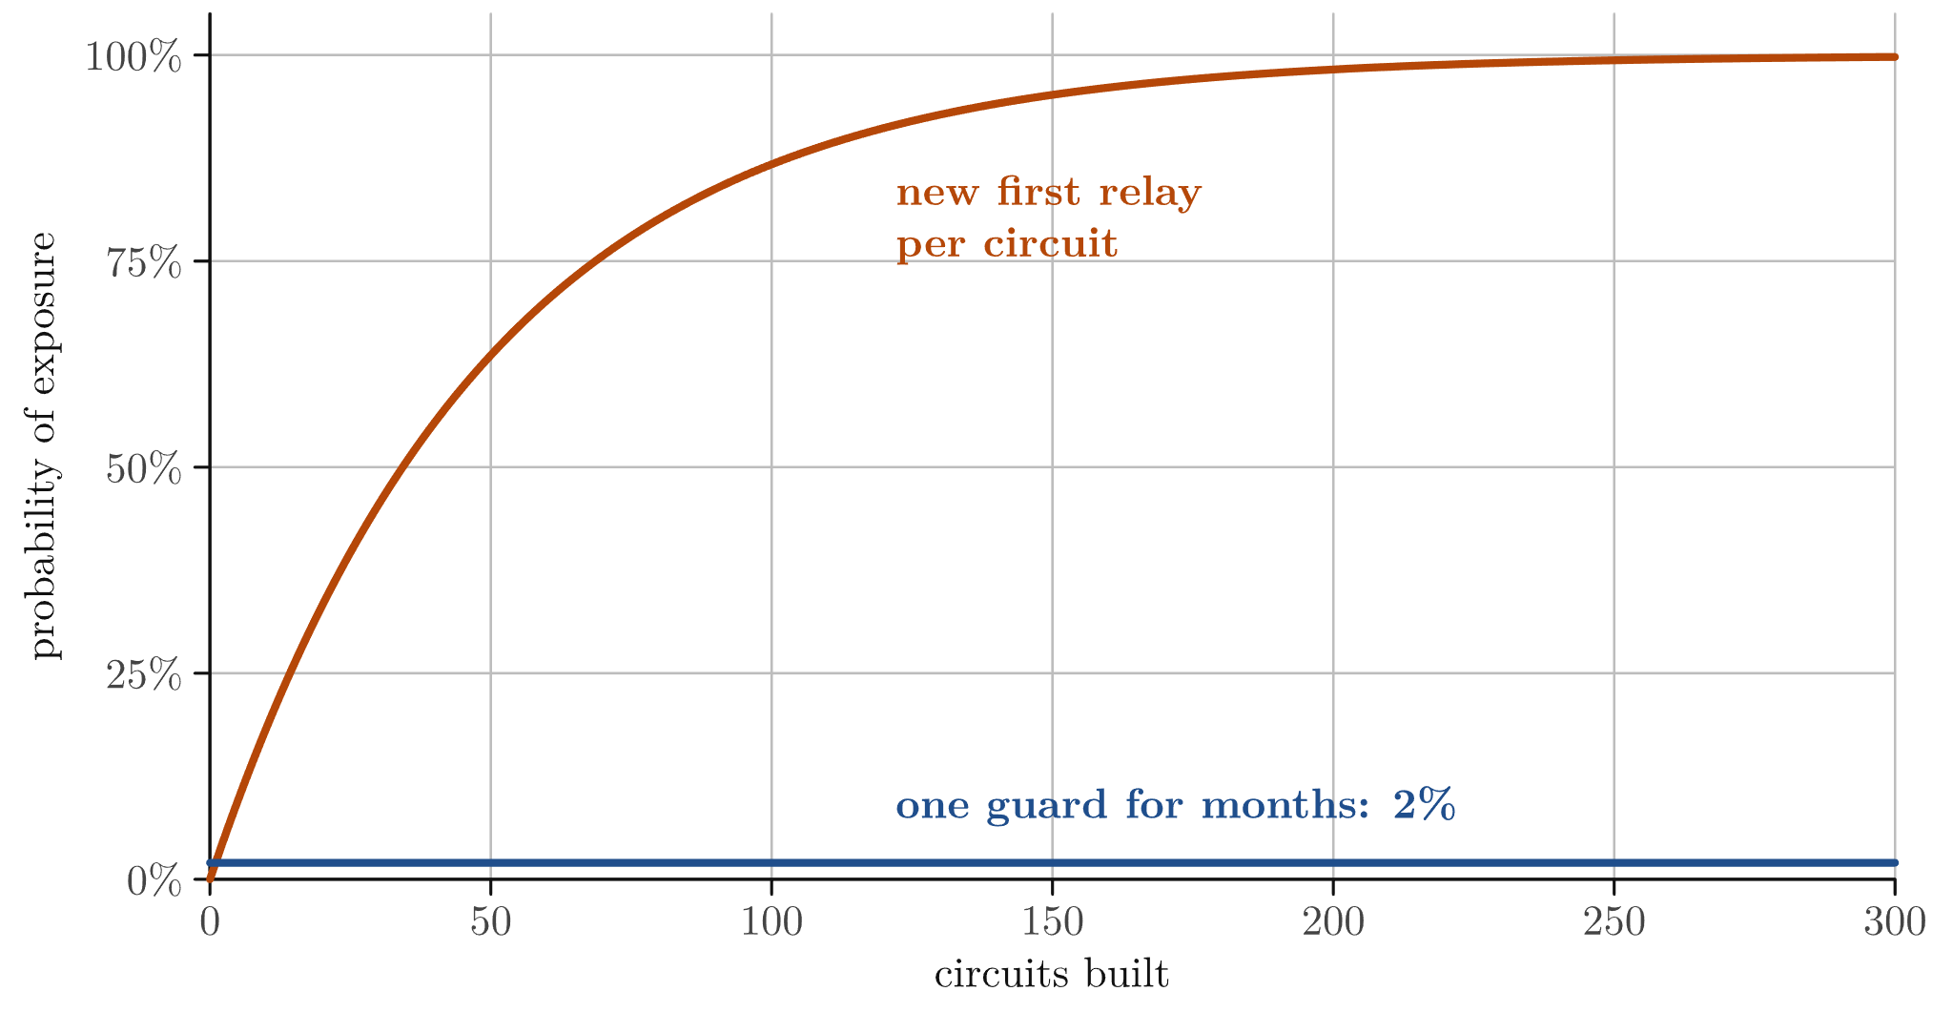
Guard selection
Model: attacker runs 2% of guard bandwidth
One guard for months: 98% of users never use a bad guard
Same total risk, concentrated on fewer users
Onion services: second hop pinned too (vanguards)
26

Slide 27
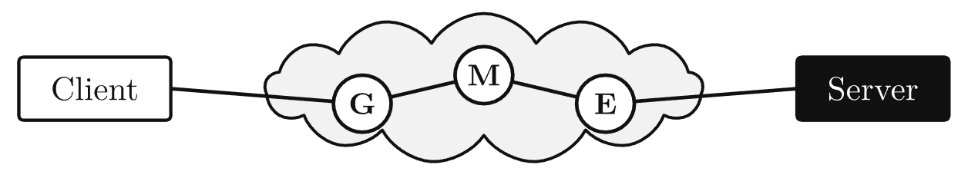
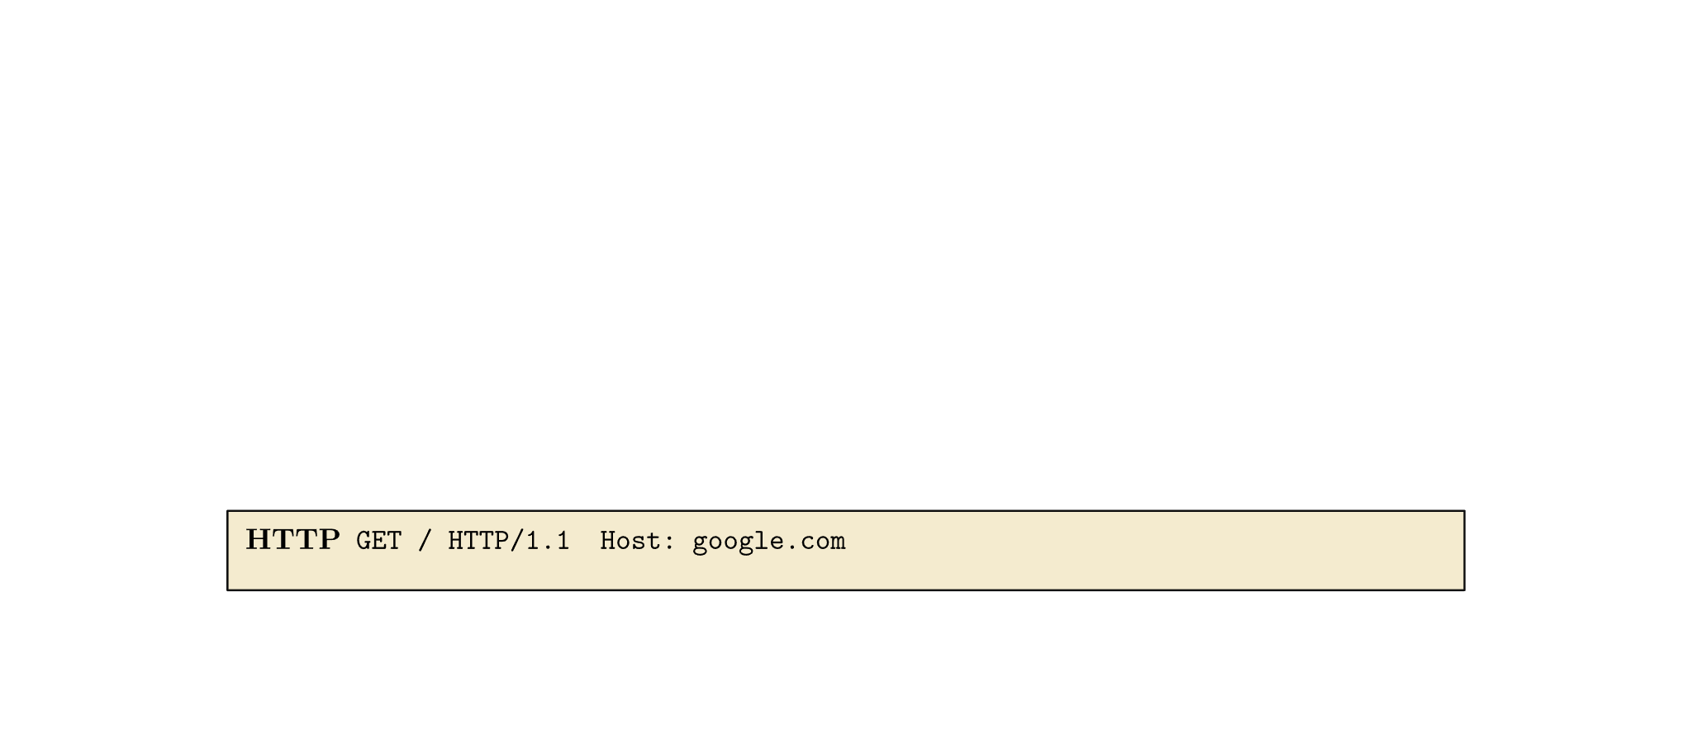
Layers in one packet
27

Slide 28
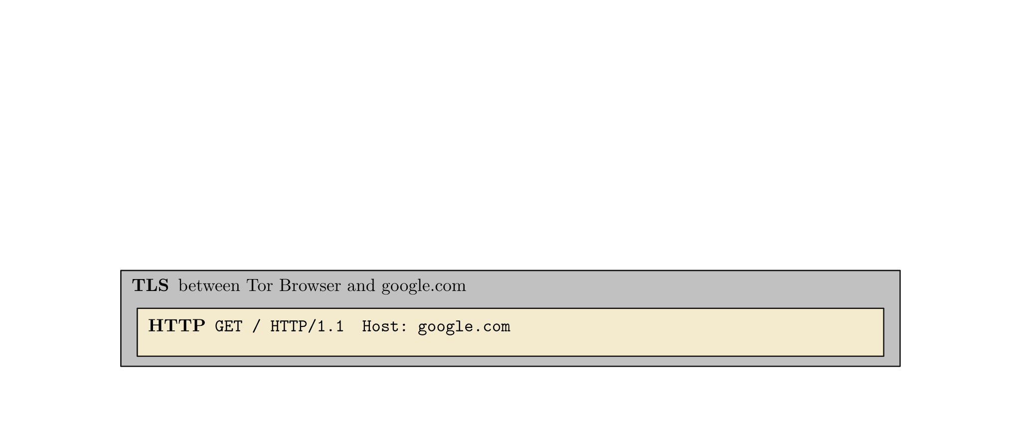
Layers in one packet
28

Slide 29
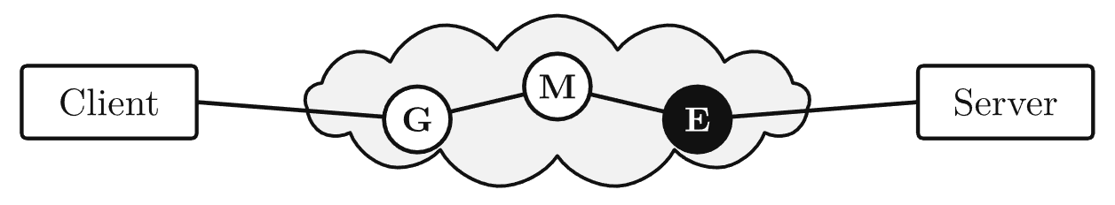
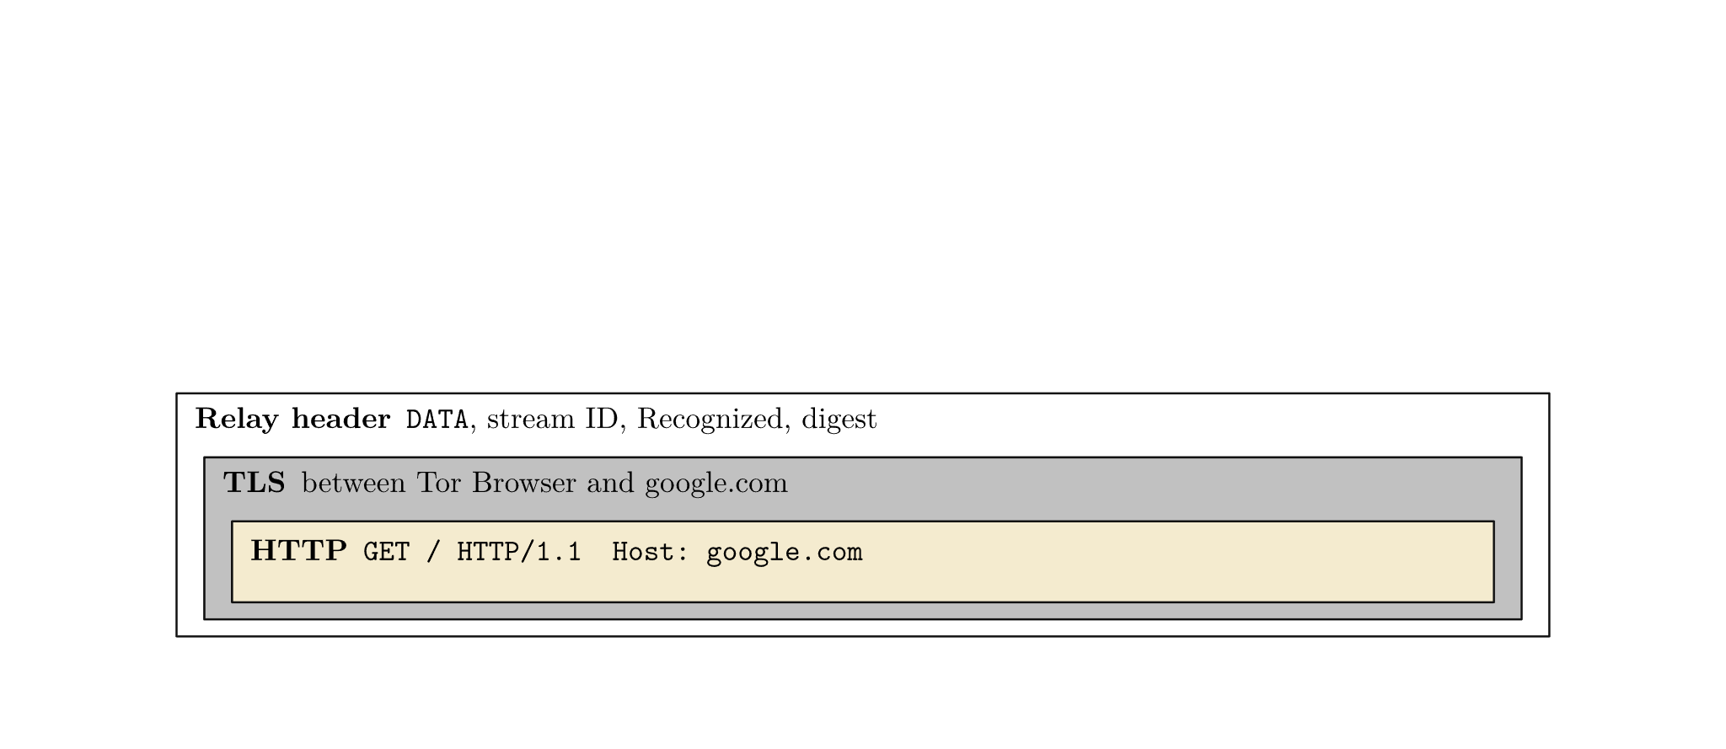
Layers in one packet
29

Slide 30
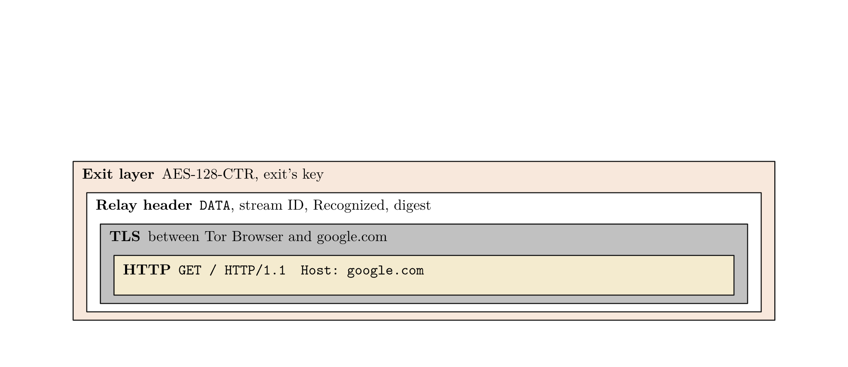
Layers in one packet
30

Slide 31
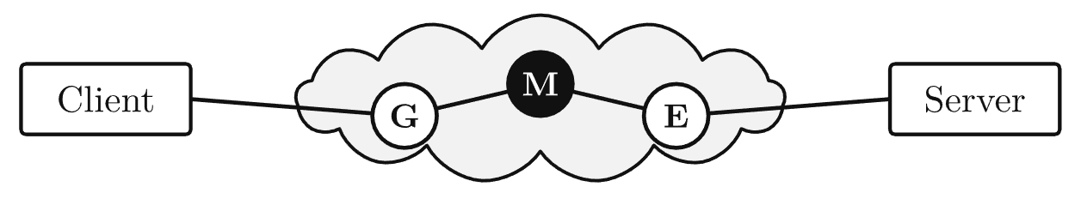
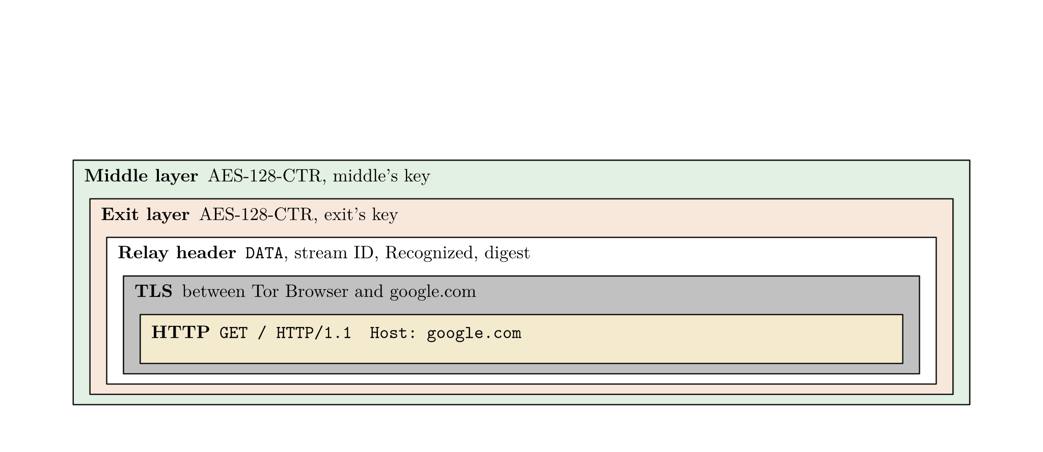
Layers in one packet
31

Slide 32
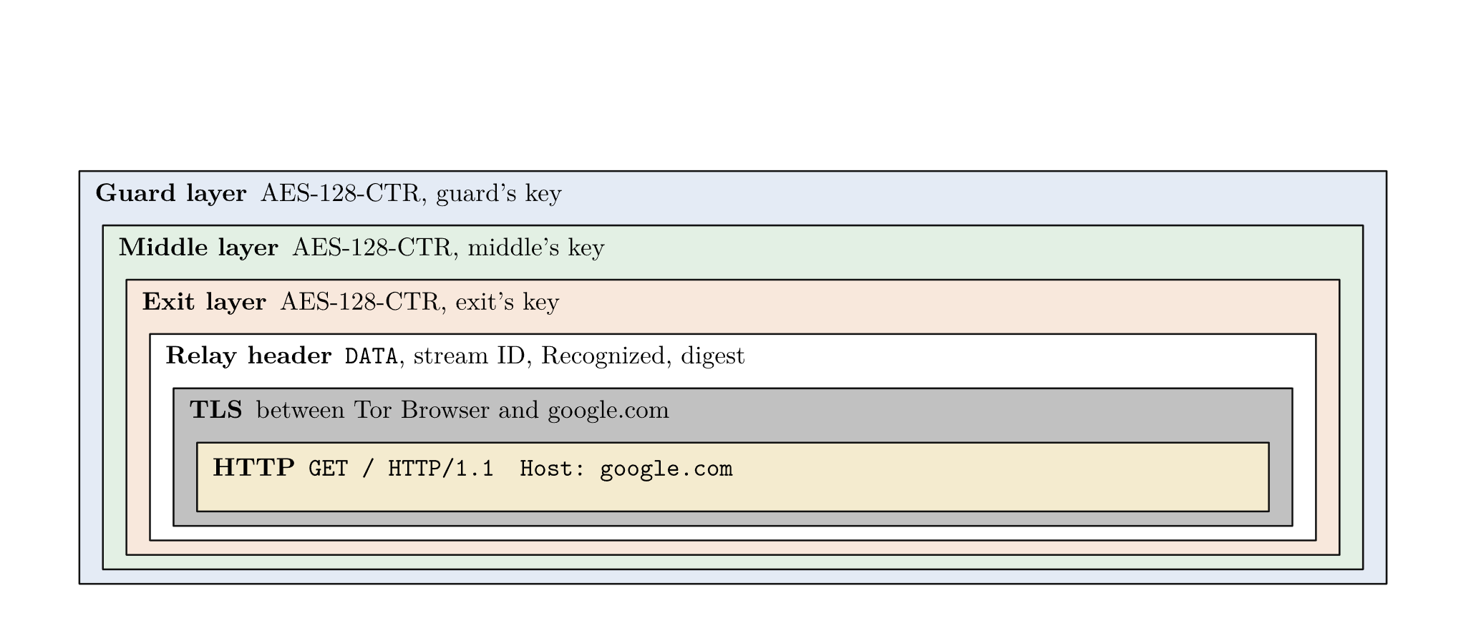
Layers in one packet
32

Slide 33
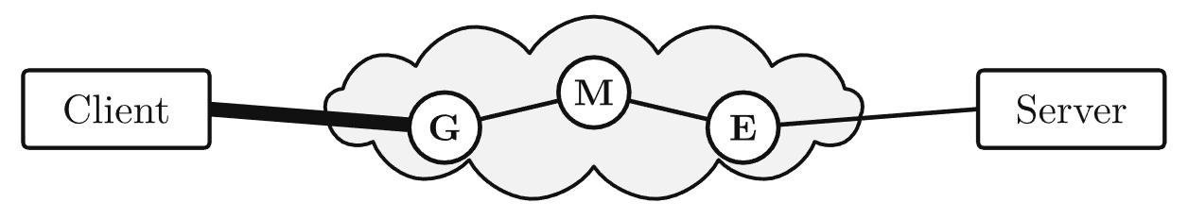
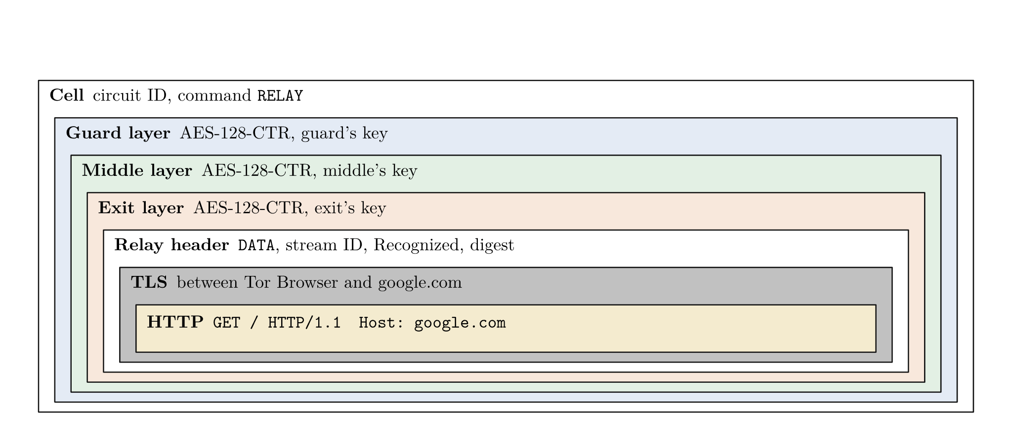
Layers in one packet
33

Slide 34
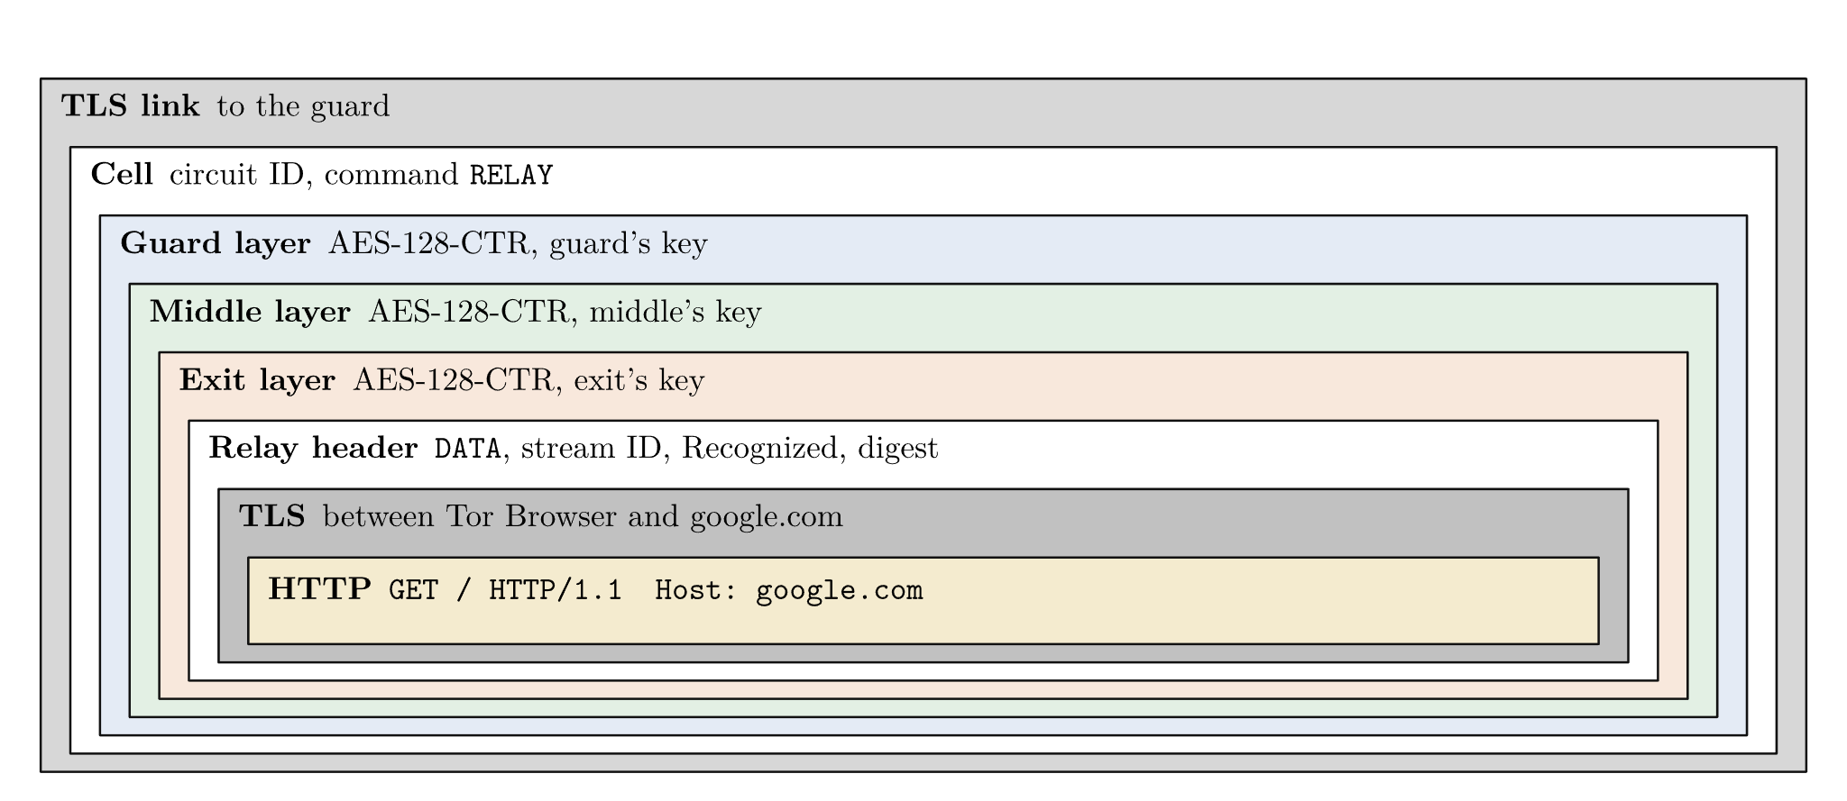
Layers in one packet
34

Slide 35
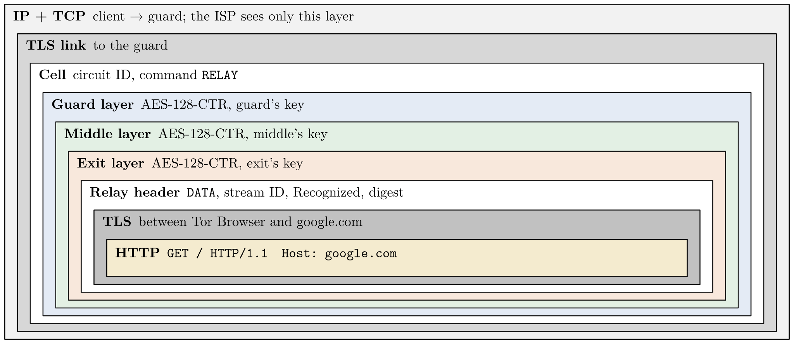
Layers in one packet
35

Slide 36
Onion Services
Part II

Slide 37
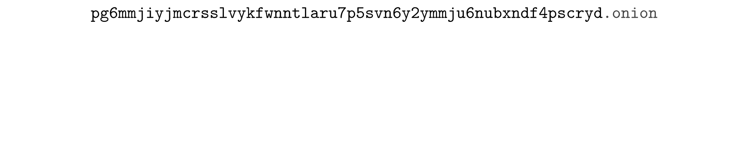
Onion addresses
37

Slide 38
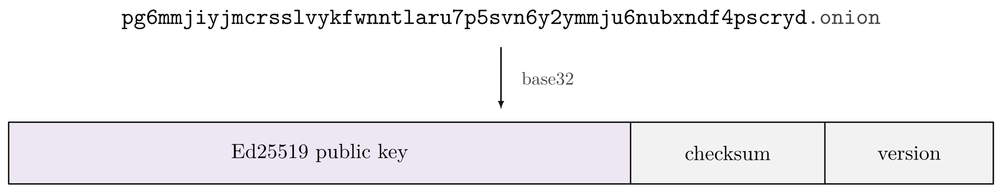
Onion addresses
38

Slide 39
Onion addresses
Self-authenticating
39

Slide 40
Onion addresses
Self-authenticating
Self-issued
40

Slide 41
Onion addresses
Self-authenticating
Self-issued
Transferable
41

Slide 42
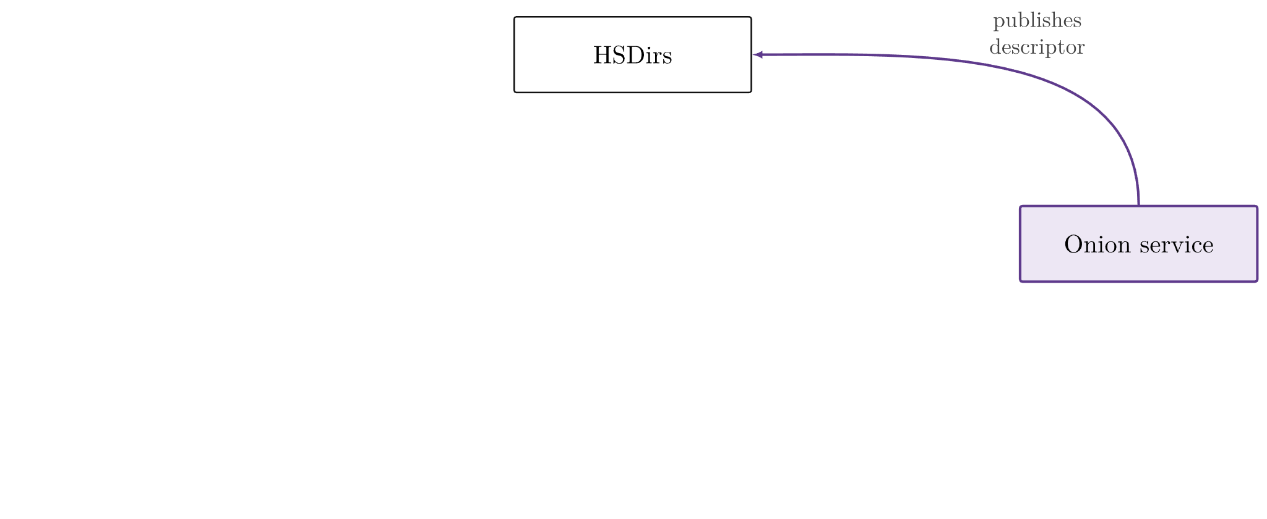
Reaching an onion service
42

Slide 43
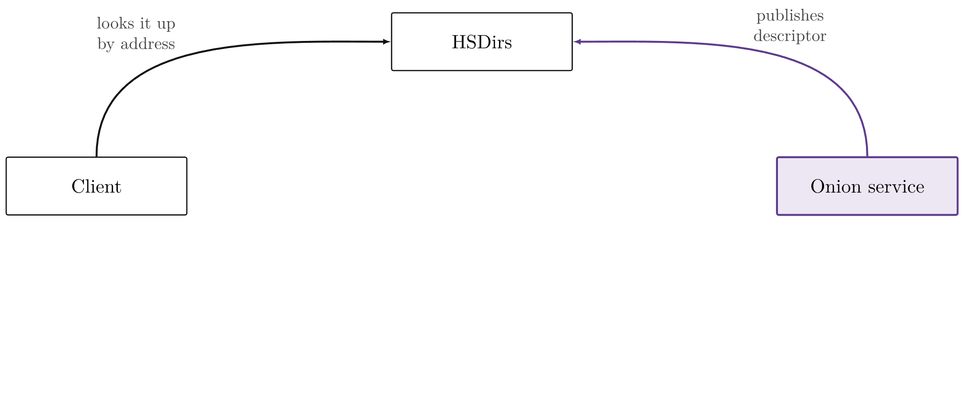
Reaching an onion service
43

Slide 44
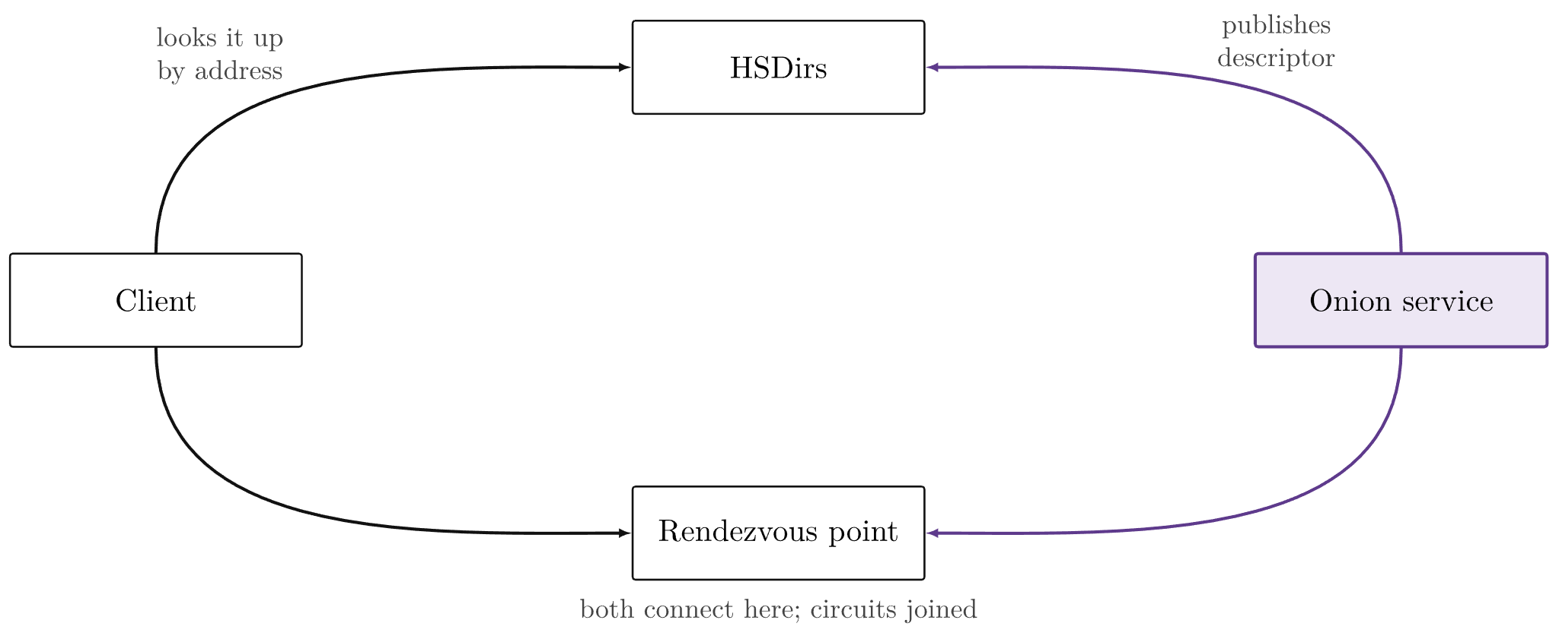
Reaching an onion service
44

Slide 45
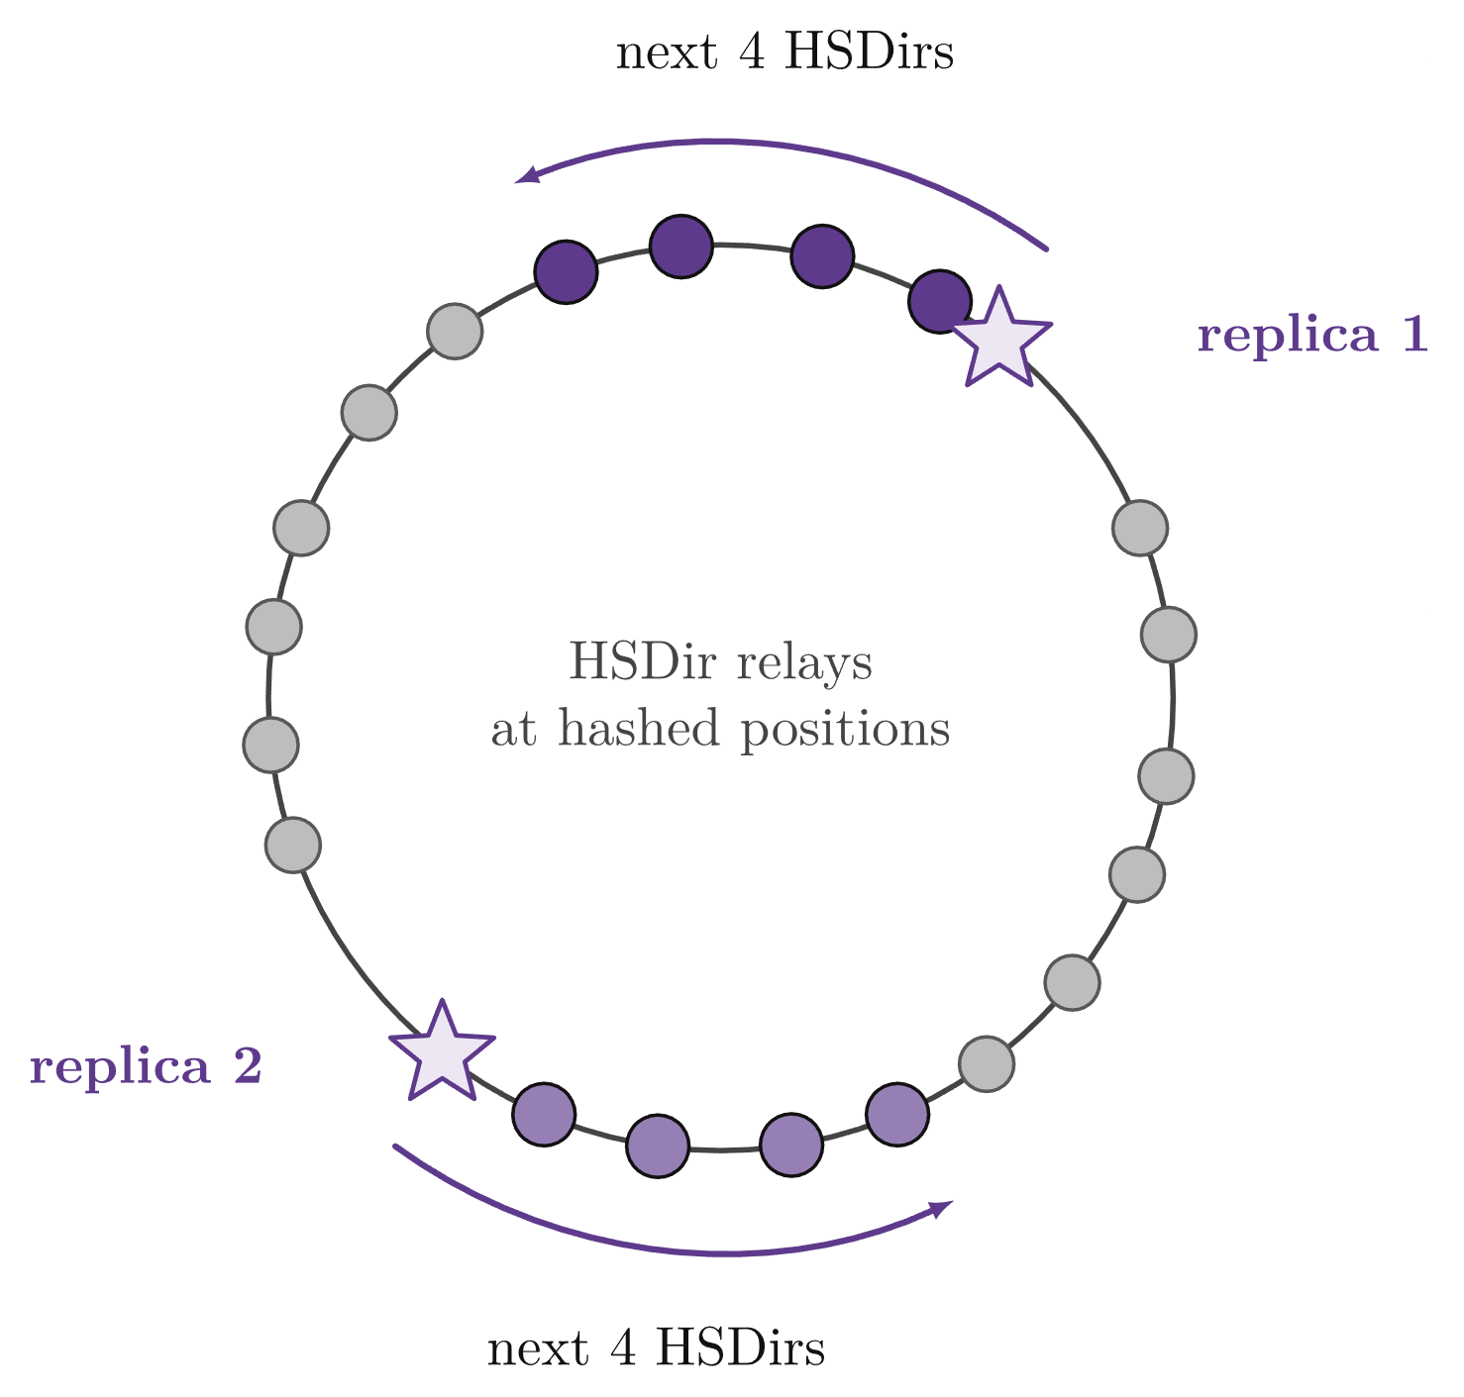
HSDir hash ring
Placement
Redundancy
Daily randomness
45

Slide 46
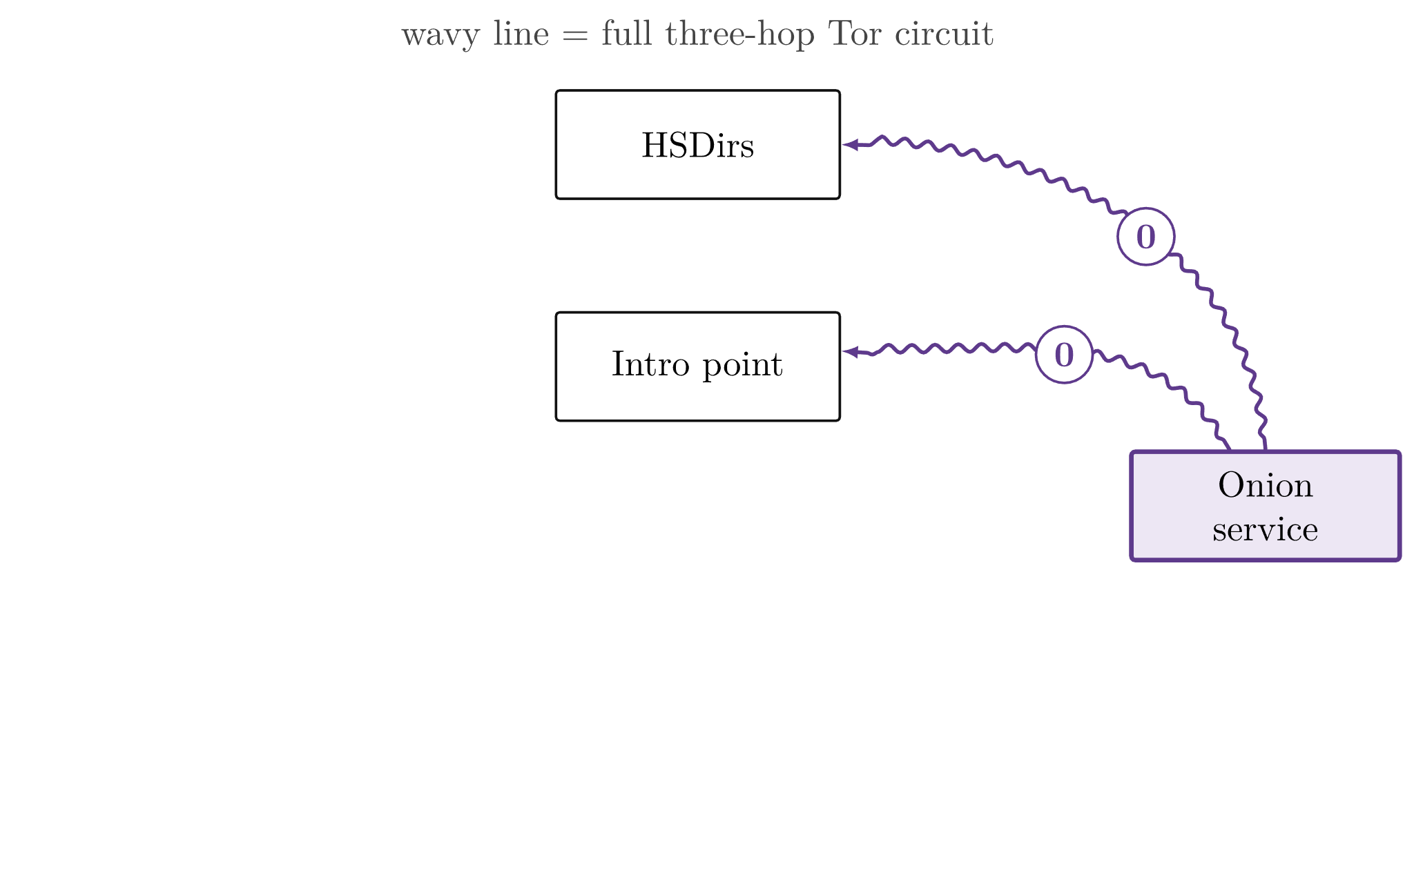
Rendezvous protocol
0
Service: circuits to 3 intro points, descriptor uploaded
46

Slide 47
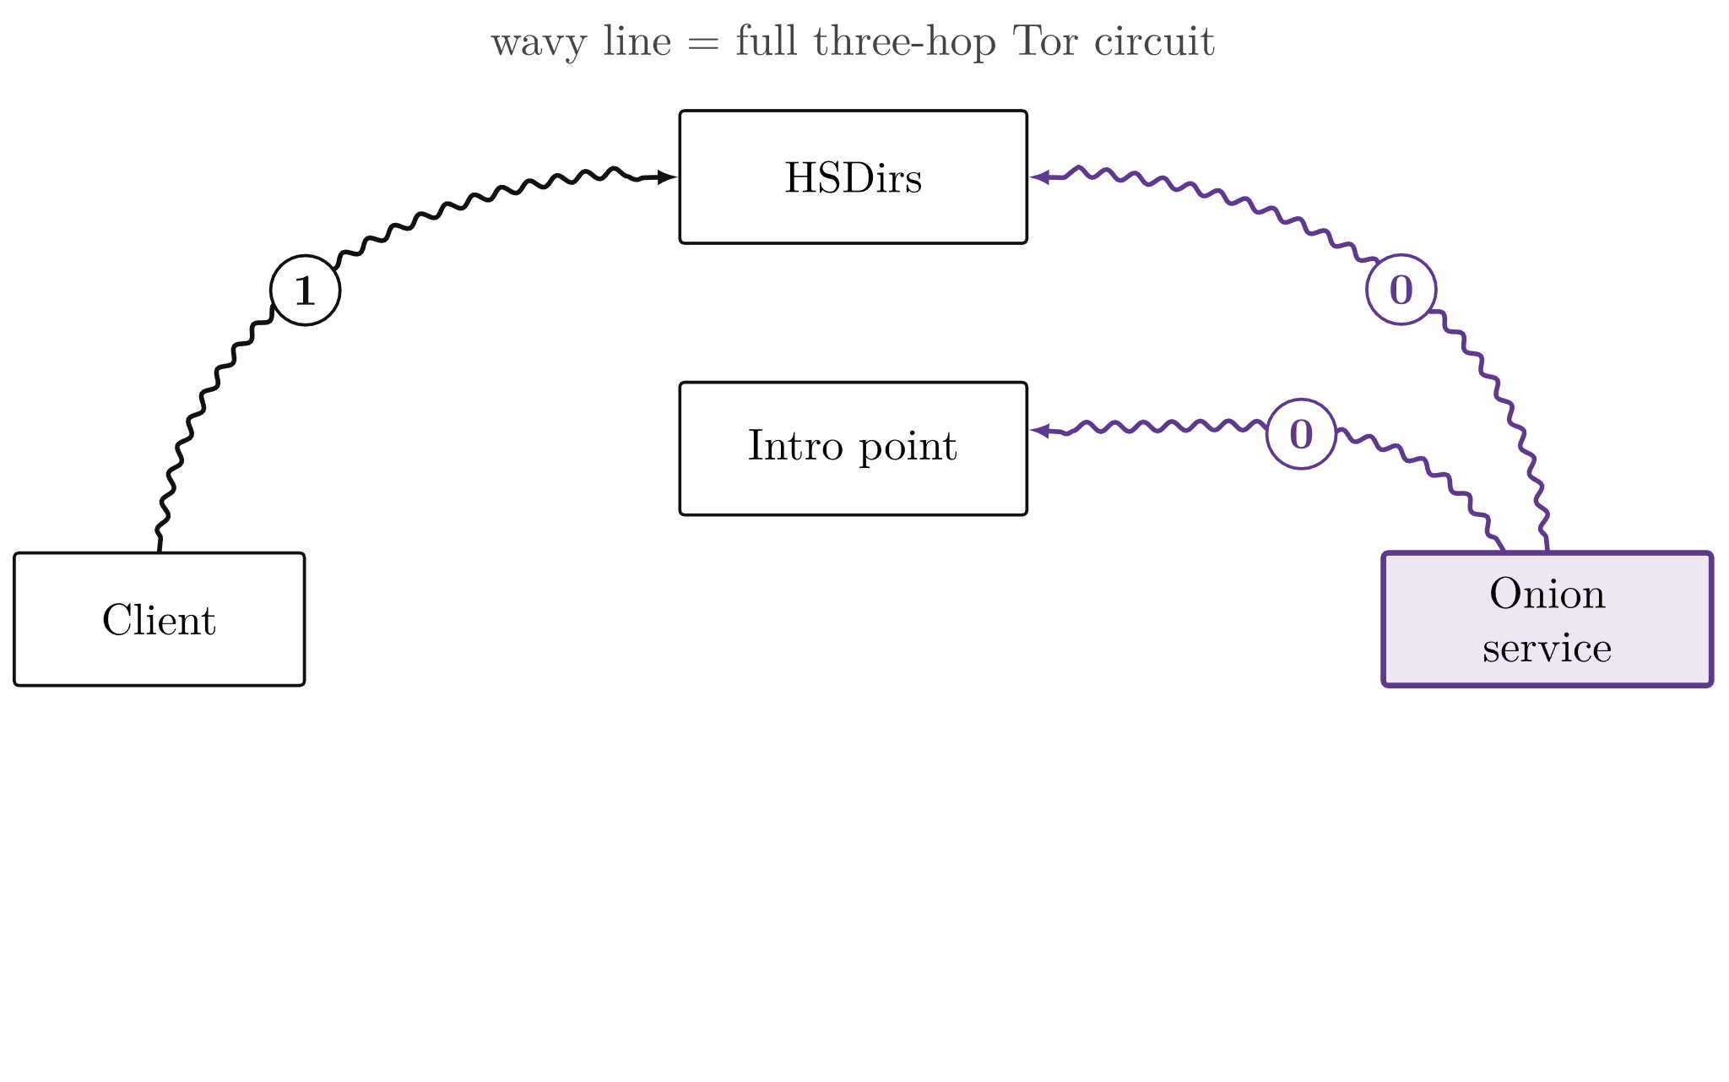
Rendezvous protocol
0
Service: circuits to 3 intro points, descriptor uploaded
1
Client fetches descriptor, decrypts with address
47

Slide 48
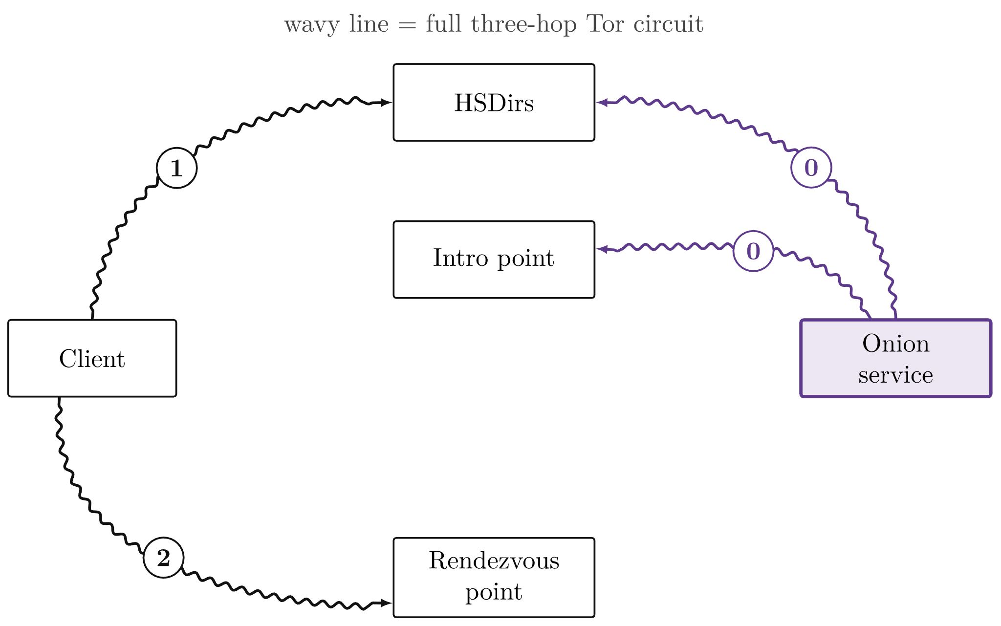
Rendezvous protocol
0
Service: circuits to 3 intro points, descriptor uploaded
1
Client fetches descriptor, decrypts with address
2
Client picks rendezvous point, leaves random cookie
48

Slide 49
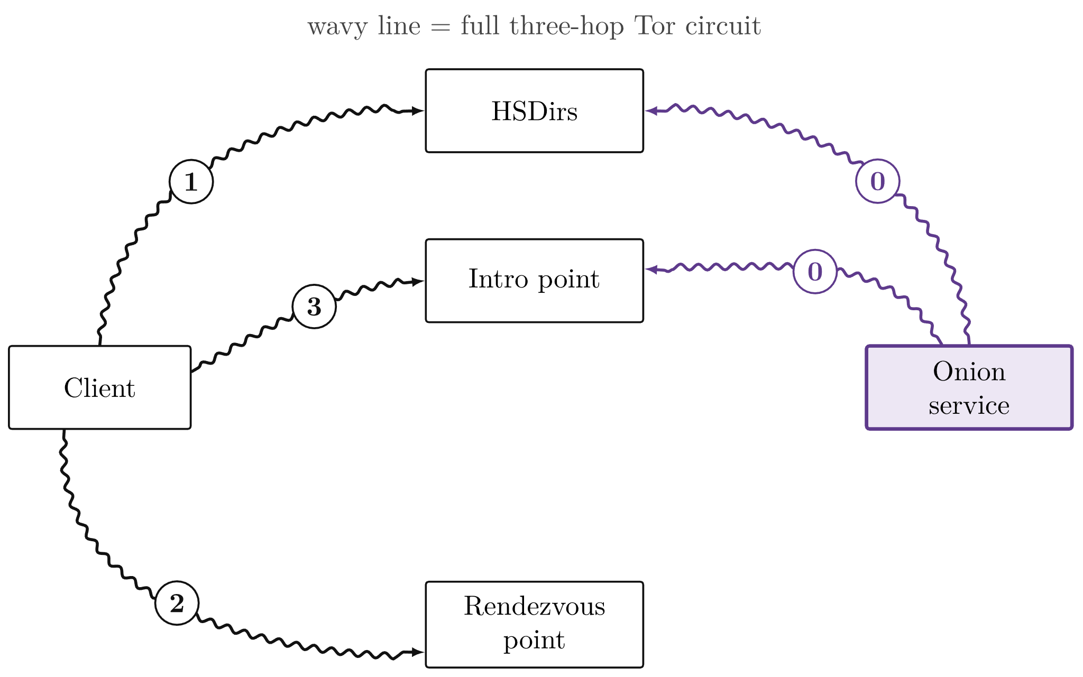
Rendezvous protocol
0
Service: circuits to 3 intro points, descriptor uploaded
1
Client fetches descriptor, decrypts with address
2
Client picks rendezvous point, leaves random cookie
3
INTRODUCE1 via intro point: cookie + rendezvous point, encrypted to service
49

Slide 50
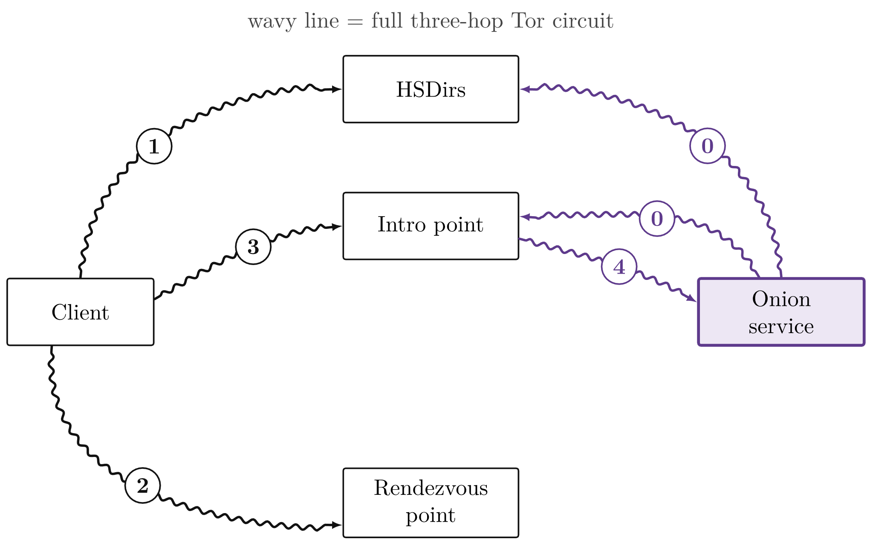
Rendezvous protocol
0
Service: circuits to 3 intro points, descriptor uploaded
1
Client fetches descriptor, decrypts with address
2
Client picks rendezvous point, leaves random cookie
3
INTRODUCE1 via intro point: cookie + rendezvous point, encrypted to service
4
Intro point forwards it (INTRODUCE2)
50

Slide 51
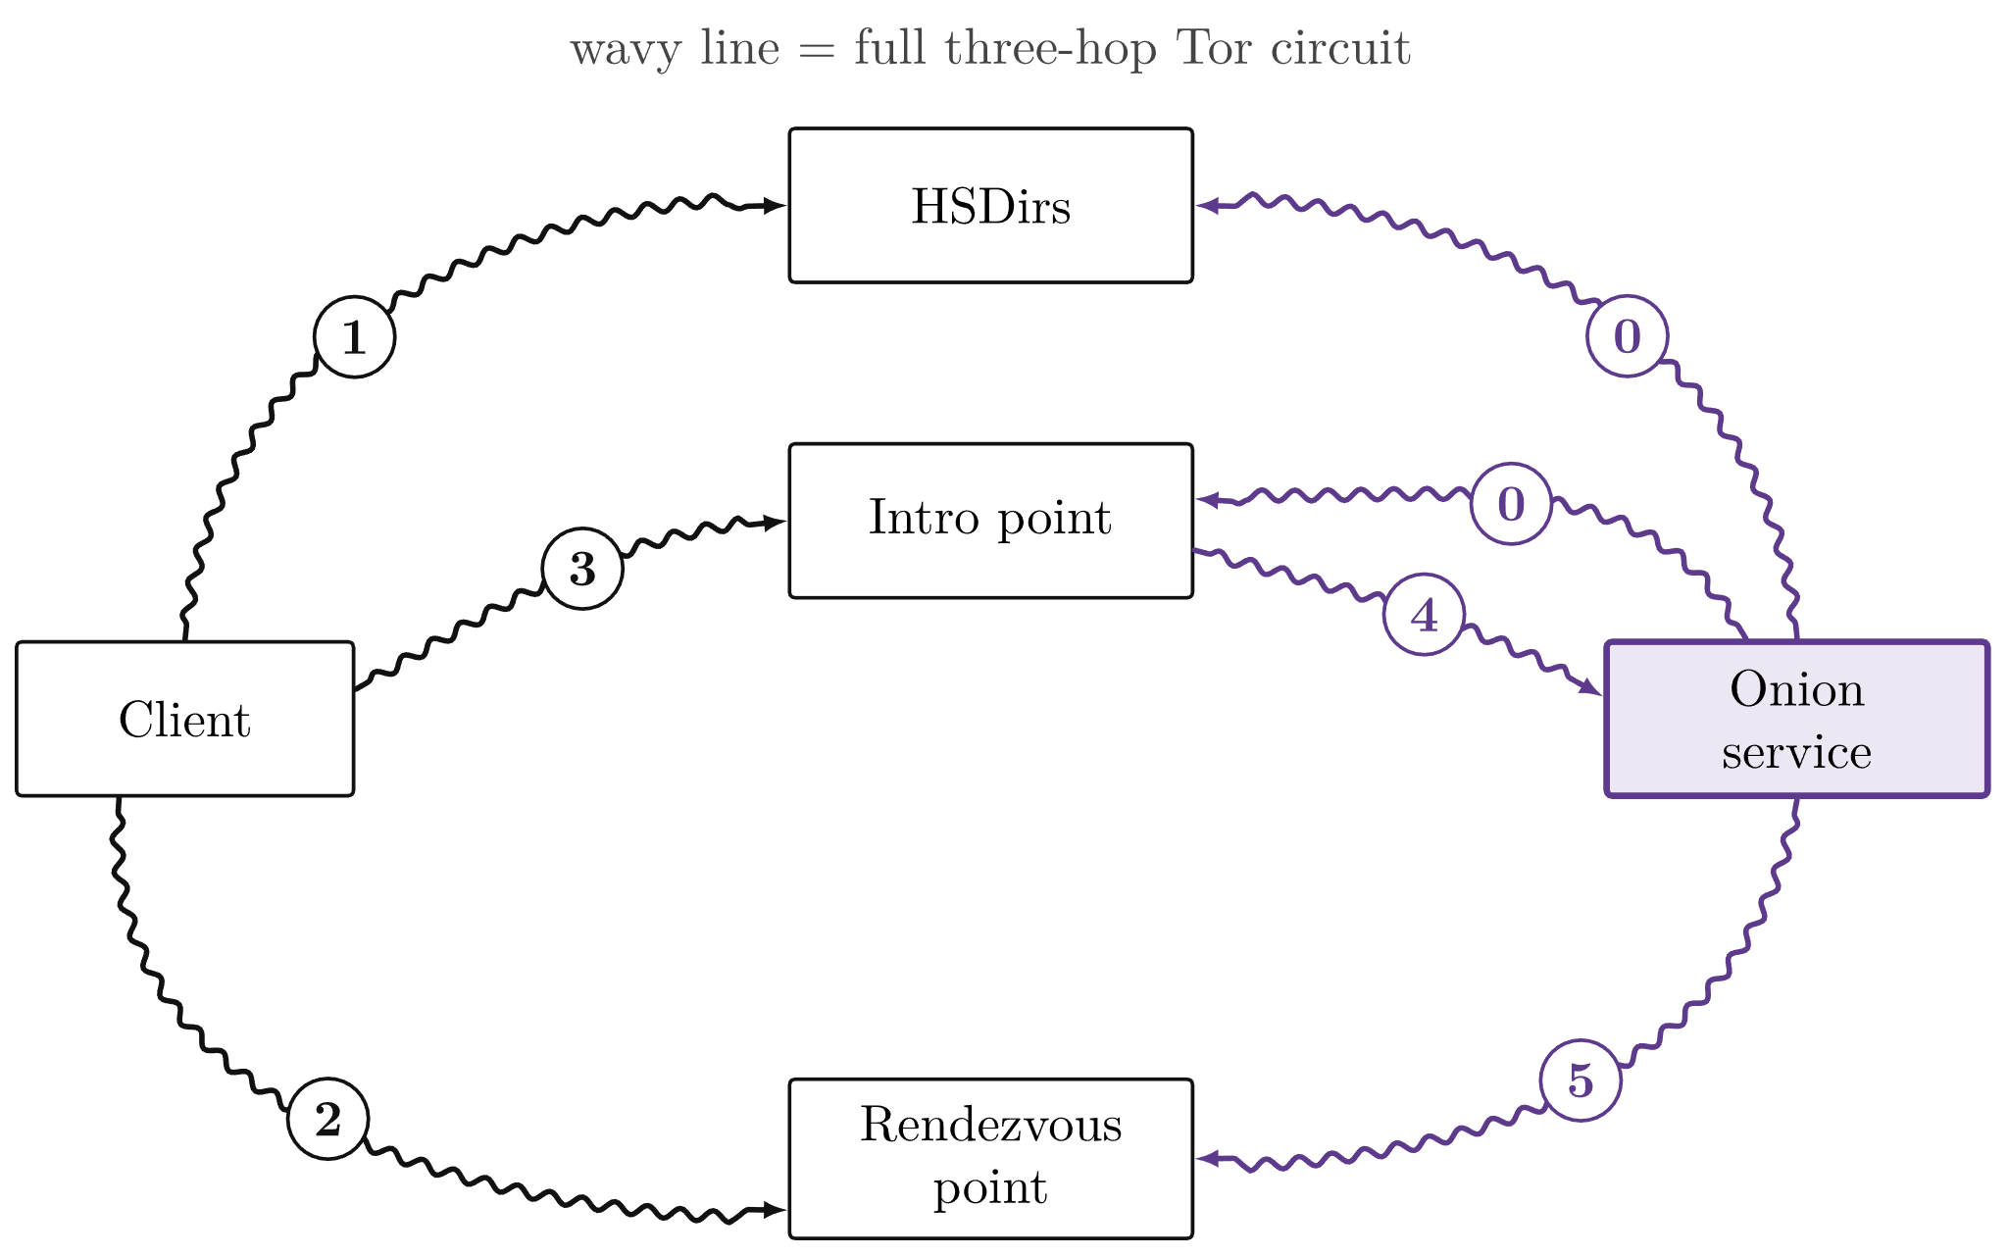
Rendezvous protocol
0
Service: circuits to 3 intro points, descriptor uploaded
1
Client fetches descriptor, decrypts with address
2
Client picks rendezvous point, leaves random cookie
3
INTRODUCE1 via intro point: cookie + rendezvous point, encrypted to service
4
Intro point forwards it (INTRODUCE2)
5
Service builds circuit to rendezvous point
51

Slide 52
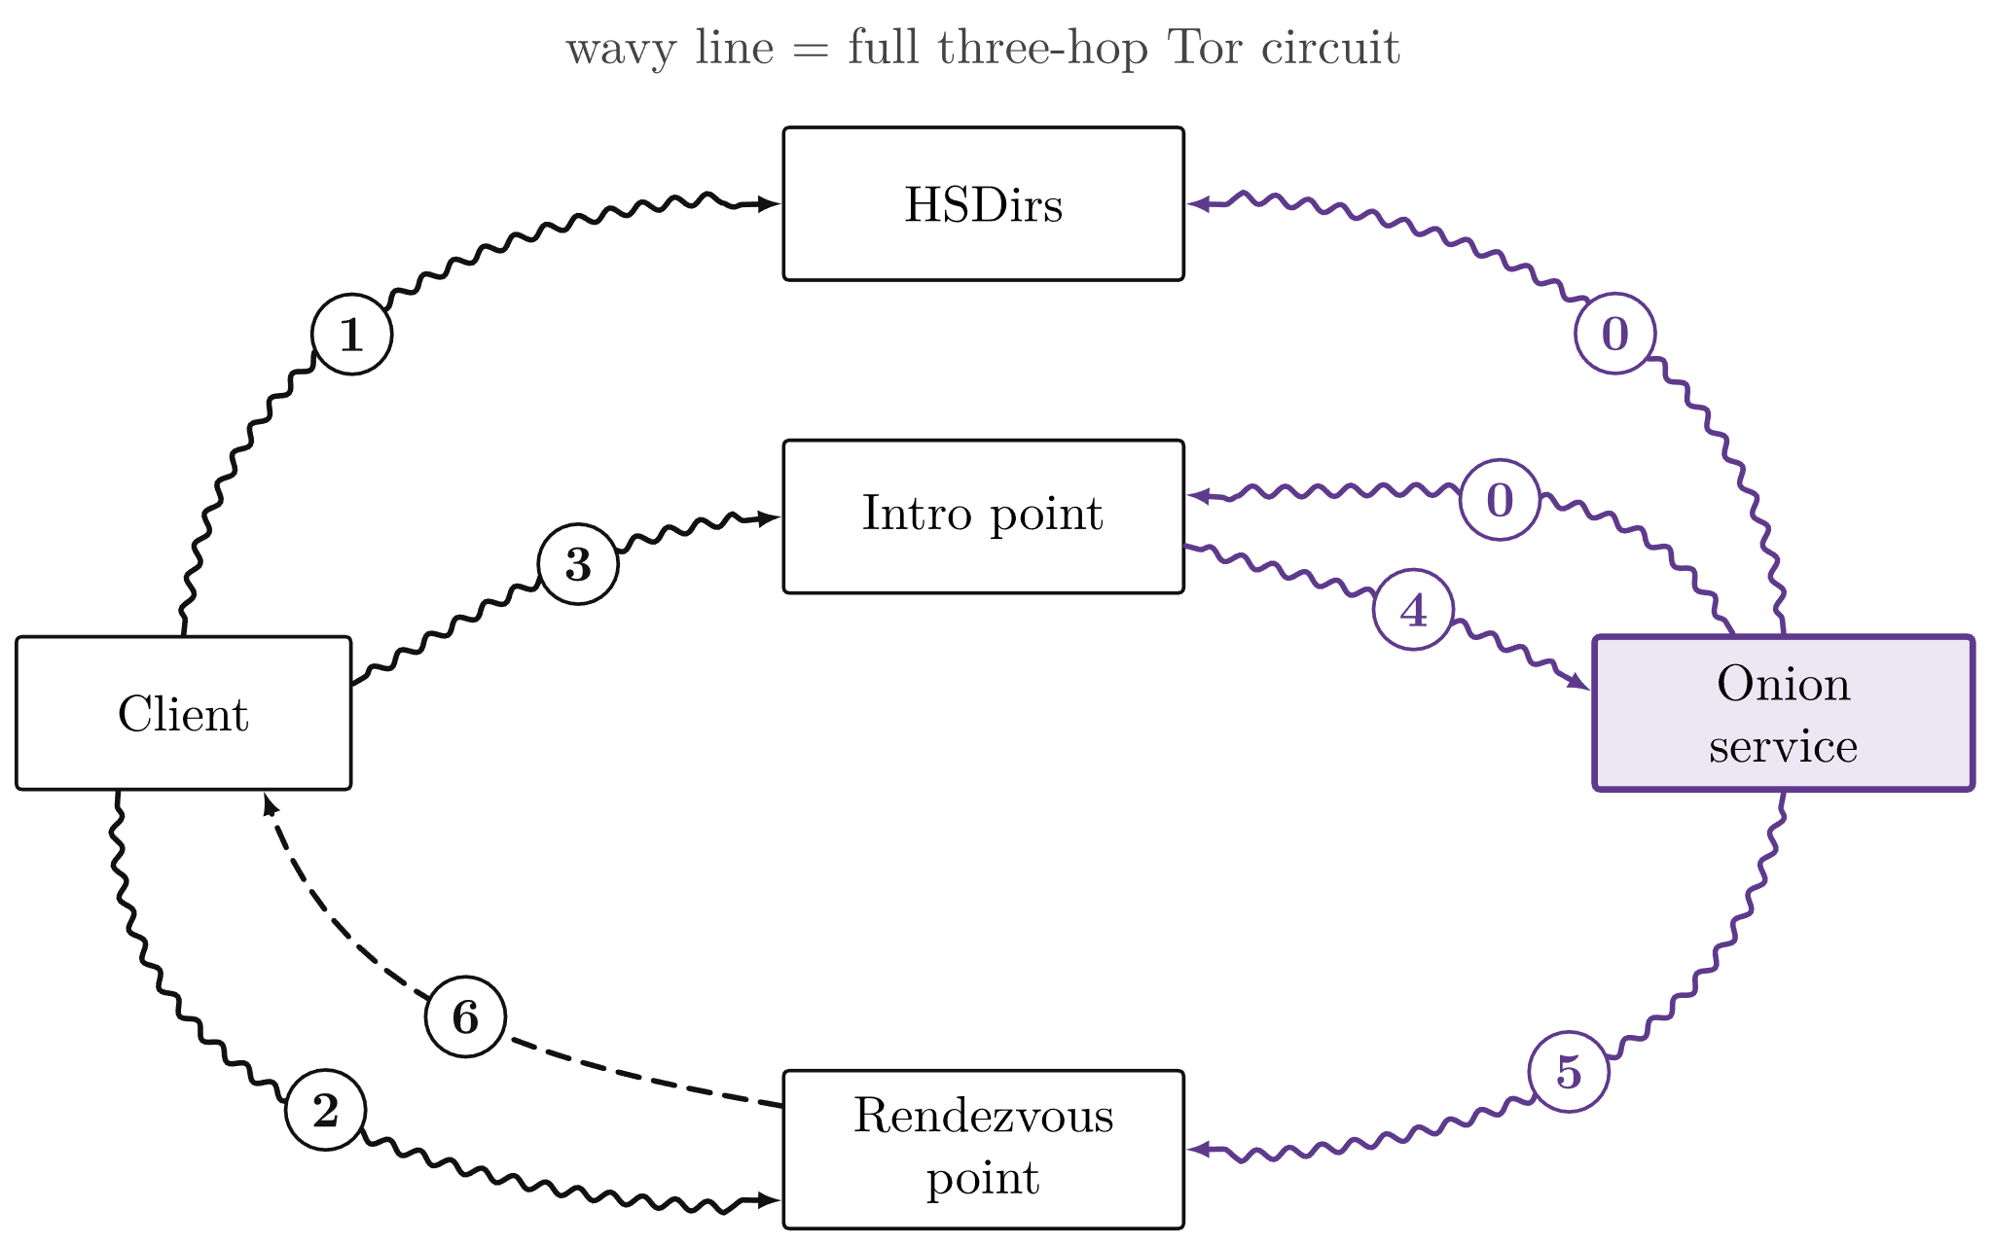
Rendezvous protocol
0
Service: circuits to 3 intro points, descriptor uploaded
1
Client fetches descriptor, decrypts with address
2
Client picks rendezvous point, leaves random cookie
3
INTRODUCE1 via intro point: cookie + rendezvous point, encrypted to service
4
Intro point forwards it (INTRODUCE2)
5
Service builds circuit to rendezvous point
6
Rendezvous point joins both circuits
52

Slide 53
Protocol isn’t bulletproof
53

Slide 54
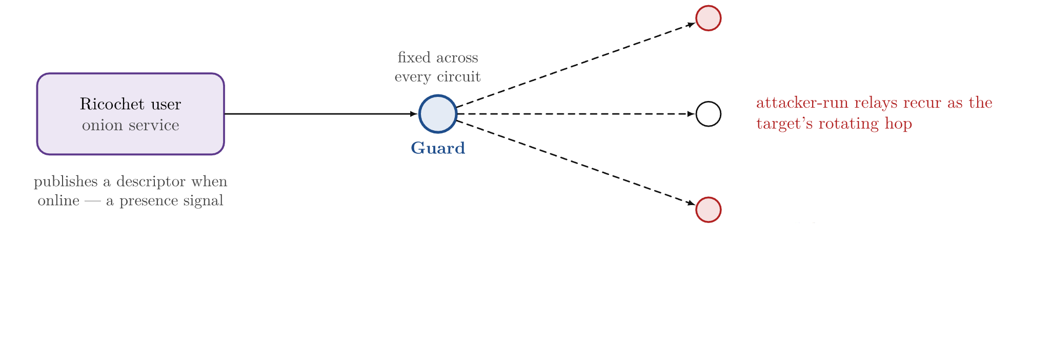
Guard discovery attack
NDR Panorama and STRG_F, Sept 2024; Tor Project, “Is Tor still safe to use?”, 2024.
54

Slide 55
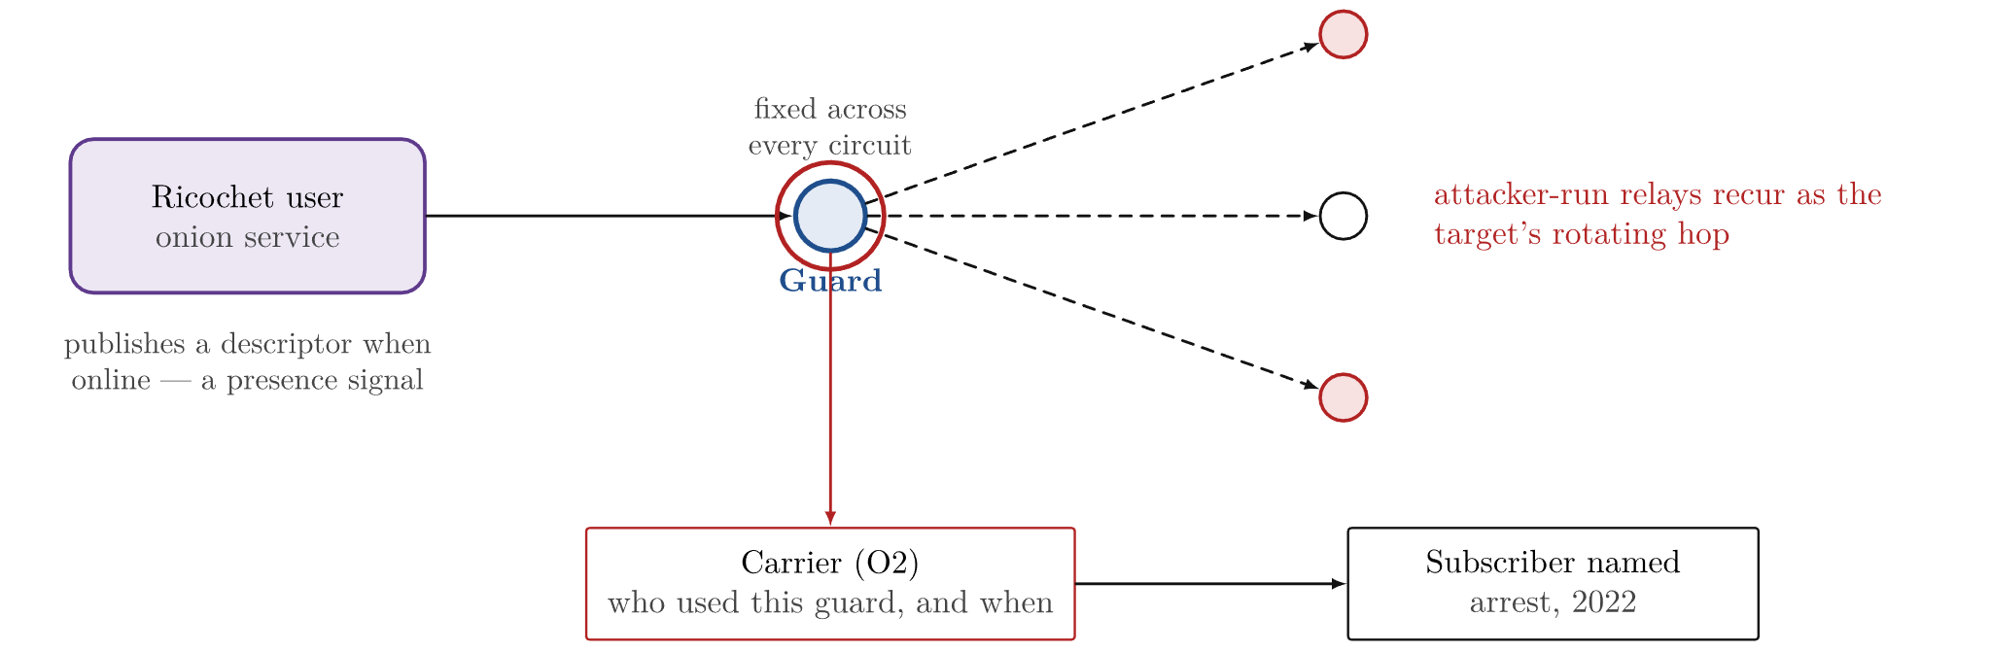
Guard discovery attack
NDR Panorama and STRG_F, Sept 2024; Tor Project, “Is Tor still safe to use?”, 2024.
55

Slide 56
KAX17
2017–2021
One operator; relays with no contact info, added in bulk
Scale
Up to ~900 relays at once; mostly guard and middle positions
nusenu, 2021; Tor Project relay removals, 8 Nov 2021.
56

Slide 57
KAX17
2017–2021
One operator; relays with no contact info, added in bulk
Scale
Up to ~900 relays at once; mostly guard and middle positions
Reach
~16% chance to be a user’s guard, ~35% a middle hop
Risk
Position enough for correlation
nusenu, 2021; Tor Project relay removals, 8 Nov 2021.
57

Slide 58
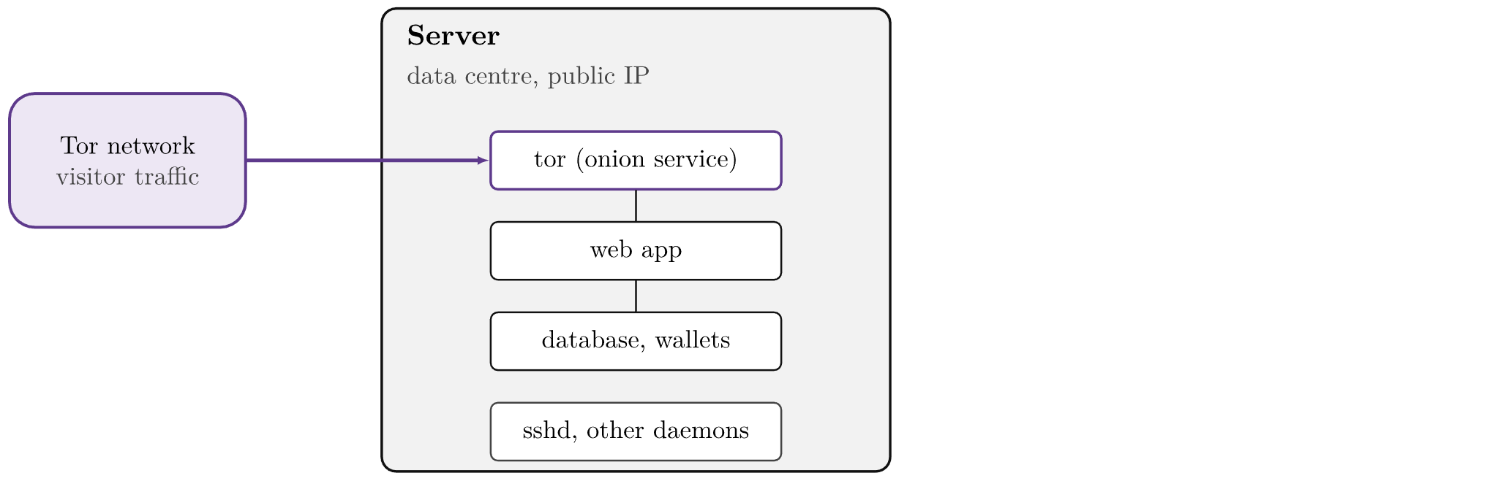
Server-side exposure
58

Slide 59

Server-side exposure
60

Slide 60

Server-side exposure
61

Slide 61
Anonymous Payments
Part III

Slide 62

Bitcoin transaction analysis
Meiklejohn et al., “A Fistful of Bitcoins”, IMC 2013.
63

Slide 63

Bitcoin transaction analysis
Meiklejohn et al., “A Fistful of Bitcoins”, IMC 2013.
64

Slide 64

Bitcoin transaction analysis
Meiklejohn et al., “A Fistful of Bitcoins”, IMC 2013.
65

Slide 65

Bitcoin transaction analysis
Meiklejohn et al., “A Fistful of Bitcoins”, IMC 2013.
66

Slide 66

Mixers and CoinJoin
US DOJ releases, 8 Nov 2024 and 19 Nov 2025.
67

Slide 67

Mixers and CoinJoin
US DOJ releases, 8 Nov 2024 and 19 Nov 2025.
68

Slide 68
Mixers and CoinJoin
Bitcoin Fog
Samourai Wallet
US DOJ releases, 8 Nov 2024 and 19 Nov 2025.
69

Slide 69
Can we design a transaction system that hides the sender, the recipient and the amount?
70

Slide 70
Monero
71

Slide 71

Monero
Ring size 16, Bulletproofs+: since Aug 2022 upgrade
72

Slide 72

Monero
Ring size 16, Bulletproofs+: since Aug 2022 upgrade
73

Slide 73

Monero
Ring size 16, Bulletproofs+: since Aug 2022 upgrade
74

Slide 74

On-ramps and off-ramps
76

Slide 75

On-ramps and off-ramps
77

Slide 76

On-ramps and off-ramps
78

Slide 77
Darknet Markets
Part IV

Slide 78

Market timeline, 2011–2025
80

Slide 79

Market timeline, 2011–2025
81

Slide 80

Market timeline, 2011–2025
82

Slide 81

Purchase flow and escrow
83

Slide 82

Purchase flow and escrow
84

Slide 83

Purchase flow and escrow
85

Slide 84

Purchase flow and escrow
86

Slide 85

Purchase flow and escrow
87

Slide 86

Purchase flow and escrow
88

Slide 87

Purchase flow and escrow
89

Slide 88

Market infrastructure
90

Slide 89

Market infrastructure
91

Slide 90

Market infrastructure
92

Slide 91

Market infrastructure
93

Slide 92
Case Studies
Part V

Slide 93

Silk Road, 2013
Admin access through a VPN
Life sentence, 2015; pardoned, January 2025
US v. Ulbricht, criminal complaint, S.D.N.Y., Sept 2013, ¶¶ 34–43.
95

Slide 94

Silk Road, 2013
A VPN login from a café
Life sentence, 2015; pardoned, January 2025
US v. Ulbricht, criminal complaint, S.D.N.Y., Sept 2013, ¶¶ 34–43.
96

Slide 95

Silk Road, 2013
A reused forum handle
Life sentence, 2015; pardoned, January 2025
US v. Ulbricht, criminal complaint, S.D.N.Y., Sept 2013, ¶¶ 34–43.
97

Slide 96

Silk Road, 2013
A coding question under his name
Life sentence, 2015; pardoned, January 2025
US v. Ulbricht, criminal complaint, S.D.N.Y., Sept 2013, ¶¶ 34–43.
98

Slide 97

Silk Road, 2013
Where the two trails meet
Life sentence, 2015; pardoned, January 2025
US v. Ulbricht, criminal complaint, S.D.N.Y., Sept 2013, ¶¶ 34–43.
99

Slide 98
AlphaBay, 2017
Personal email in system-generated mail
Died in custody, 12 July 2017
Mail headers, 2014
Pimp_Alex_91@hotmail.com
US v. Cazes, civil forfeiture complaint, E.D. Cal., Jul 2017, as reported; DOJ, 20 Jul 2017.
100

Slide 99
AlphaBay, 2017
Personal email in system-generated mail
Died in custody, 12 July 2017
Mail headers, 2014
Pimp_Alex_91@hotmail.com
Handle
“Alpha02”
US v. Cazes, civil forfeiture complaint, E.D. Cal., Jul 2017, as reported; DOJ, 20 Jul 2017.
101

Slide 100
AlphaBay, 2017
Personal email in system-generated mail
Died in custody, 12 July 2017
Mail headers, 2014
Pimp_Alex_91@hotmail.com
Handle
“Alpha02”
Identity
EBX Technologies
US v. Cazes, civil forfeiture complaint, E.D. Cal., Jul 2017, as reported; DOJ, 20 Jul 2017.
102

Slide 101
AlphaBay, 2017
Personal email in system-generated mail
Died in custody, 12 July 2017
Mail headers, 2014
Pimp_Alex_91@hotmail.com
Handle
“Alpha02”
Identity
EBX Technologies
Arrest, 5 July 2017
Bangkok
US v. Cazes, civil forfeiture complaint, E.D. Cal., Jul 2017, as reported; DOJ, 20 Jul 2017.
103

Slide 102

Hansa, 2017
Police takeover
Admins arrested in Germany, 20 June 2017
Dutch National Police and Europol, 20 Jul 2017; Wired, “Operation Bayonet”, Mar 2018.
104

Slide 103

Hansa, 2017
Police takeover
Admins arrested in Germany, 20 June 2017
Dutch National Police and Europol, 20 Jul 2017; Wired, “Operation Bayonet”, Mar 2018.
105

Slide 104

Hansa, 2017
Police takeover
Admins arrested in Germany, 20 June 2017
Dutch National Police and Europol, 20 Jul 2017; Wired, “Operation Bayonet”, Mar 2018.
106

Slide 105

Hansa, 2017
Police takeover
Admins arrested in Germany, 20 June 2017
Dutch National Police and Europol, 20 Jul 2017; Wired, “Operation Bayonet”, Mar 2018.
107

Slide 106

Hansa, 2017
Police takeover
Admins arrested in Germany, 20 June 2017
20 June – 20 July 2017: site operated by Dutch National Police
Dutch National Police and Europol, 20 Jul 2017; Wired, “Operation Bayonet”, Mar 2018.
108

Slide 107

Hansa, 2017
Changes under police control
Dutch National Police and Europol, 20 Jul 2017; Wired, “Operation Bayonet”, Mar 2018.
109

Slide 108

Hansa, 2017
Changes under police control
Photos wiped
Dutch National Police and Europol, 20 Jul 2017; Wired, “Operation Bayonet”, Mar 2018.
110

Slide 109

Hansa, 2017
Changes under police control
Photos wiped
Dutch National Police and Europol, 20 Jul 2017; Wired, “Operation Bayonet”, Mar 2018.
111

Slide 110

Hansa, 2017
Changes under police control
Photos wiped
Dutch National Police and Europol, 20 Jul 2017; Wired, “Operation Bayonet”, Mar 2018.
112

Slide 111
Hansa, 2017
Changes under police control
Photos wiped
Passwords logged
Beacon file
~10,000 addresses
Dutch National Police and Europol, 20 Jul 2017; Wired, “Operation Bayonet”, Mar 2018.
113

Slide 112

Wall Street Market, 2019
VPN failure, admin’s real IP
Admins arrested 23–24 April 2019
US v. Lousee, Kalla & Frost, complaint, C.D. Cal., May 2019, ¶¶ 23–25; DOJ, 3 May 2019.
114

Slide 113

Wall Street Market, 2019
VPN failure, admin’s real IP
Admins arrested 23–24 April 2019
US v. Lousee, Kalla & Frost, complaint, C.D. Cal., May 2019, ¶¶ 23–25; DOJ, 3 May 2019.
115

Slide 114

Wall Street Market, 2019
VPN failure, admin’s real IP
Admins arrested 23–24 April 2019
US v. Lousee, Kalla & Frost, complaint, C.D. Cal., May 2019, ¶¶ 23–25; DOJ, 3 May 2019.
116

Slide 115

Wall Street Market, 2019
Connection timing, PGP key reuse
US v. Lousee, Kalla & Frost, complaint, C.D. Cal., May 2019, ¶¶ 27–31.
117

Slide 116

Wall Street Market, 2019
Connection timing, PGP key reuse
Hansa data: seized 2017
US v. Lousee, Kalla & Frost, complaint, C.D. Cal., May 2019, ¶¶ 27–31.
118

Slide 117

Wall Street Market, 2019
Connection timing, PGP key reuse
Hansa data: seized 2017
US v. Lousee, Kalla & Frost, complaint, C.D. Cal., May 2019, ¶¶ 27–31.
119

Slide 118

Incognito Market, 2024
Cryptocurrency exchange KYC records
Pleaded guilty Dec 2024; 30 years, Feb 2026
Oct 2020 – Mar 2024; $105M+ in drugs; 400,000+ buyer accounts
DOJ (S.D.N.Y.), May 2024 and 3 Feb 2026; complaint details as reported.
120

Slide 119

Incognito Market, 2024
Cryptocurrency exchange KYC records
Pleaded guilty Dec 2024; 30 years, Feb 2026
Oct 2020 – Mar 2024; $105M+ in drugs; 400,000+ buyer accounts
DOJ (S.D.N.Y.), May 2024 and 3 Feb 2026; complaint details as reported.
121

Slide 120

Incognito Market, 2024
Cryptocurrency exchange KYC records
Pleaded guilty Dec 2024; 30 years, Feb 2026
Oct 2020 – Mar 2024; $105M+ in drugs; 400,000+ buyer accounts
DOJ (S.D.N.Y.), May 2024 and 3 Feb 2026; complaint details as reported.
122

Slide 121
Case summary
Case
Identifying information
Layer
Silk Road, 2013
VPN login records; handles reused since 2011
admin access, identity
AlphaBay, 2017
personal email in site mail headers
configuration
Hansa, 2017
dev server → chat logs; then platform takeover
hosting, platform
Wall Street Market, 2019
dropped VPN, ISP timing, reused PGP key
network, identity
Incognito, 2024
exchange account, domain in his name
money
Bitcoin Fog, 2021
2011 exchange records linked to hosting payments
money
Every case: identifying information from outside the Tor protocol
127

Slide 122
Thanks
Tim K.
tkudabae@uwaterloo.ca
133

Slide 123
References
Court filings and official statements
[1]
US v. Ulbricht, S.D.N.Y.: complaint, Sept 2013; Tarbell declaration, Sept 2014; suppression ruling, Oct 2014.
[2]
US v. Cazes, civil forfeiture complaint, E.D. Cal., Jul 2017; DOJ, 20 Jul 2017.
[3]
US v. Lousee, Kalla & Frost, complaint, C.D. Cal., May 2019; DOJ and BKA, 3 May 2019.
[4]
US v. Rui-Siang Lin, S.D.N.Y.: DOJ, May 2024 and 3 Feb 2026.
[5]
US v. Farrell, W.D. Wash., order of 23 Feb 2016.
[6]
Bitcoin Fog: DOJ, 8 Nov 2024. Samourai Wallet: DOJ, 19 Nov 2025.
[7]
Dutch National Police and Europol on Hansa, 20 Jul 2017; Europol on DisrupTor (Sep 2020) and RapTor (May 2025).
Background
[8]
“How Tor Works: building it up from the ordinary internet” (handout); spec.torproject.org.
[9]
Tor Project, “relay early” traffic confirmation attack advisory, 30 Jul 2014.
[10]
Tor Project, Arti 2.5.0 release notes (Counter Galois Onion), 30 Jun 2026.
[11]
A. Greenberg, “Operation Bayonet”, Wired, Mar 2018; Tracers in the Dark, 2022.
[12]
Meiklejohn et al., “A Fistful of Bitcoins”, IMC 2013.
[13]
Möser et al., “An Empirical Analysis of Traceability in the Monero Blockchain”, PoPETs 2018.
[14]
R. Graham, Errata Security, Oct 2014; Malwarebytes, Apr 2019; ZDNet, May 2019; AFP and DCD on the Cyberbunker, 2019–21.
134

